Slide 1
Neural Network Initialization Project
By: Meidar sharkansky

Slide 2
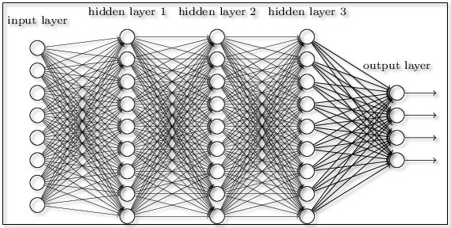
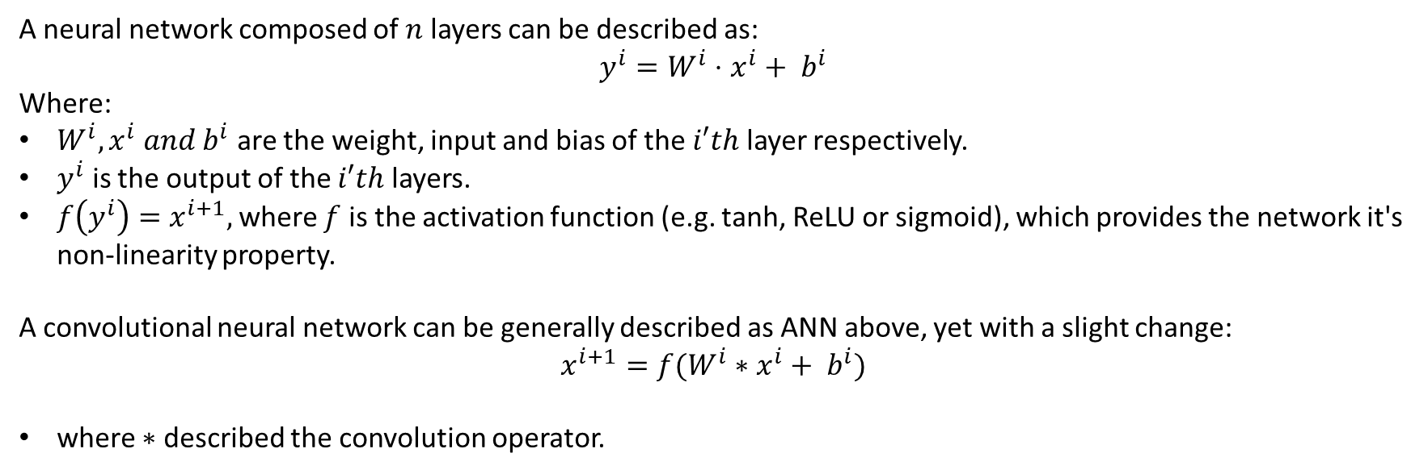
Brief And General Overview Of ANN And CNN
A neural network composed of $n$ layers can be described as:
$$y^{i}=W^{i}⋅x^{i}+ b^{i}$$
Where:
$W^{i}, x^{i} and b^{i}$ are the weight, input and bias of the $i′th$ layer respectively.
$y^{i}$ is the output of the $i′th$ layers.
$f\left(y^{i}\right)=x^{i+1},$where $f$ is the activation function (e.g. tanh, ReLU or sigmoid), which provides the network it's non-linearity property.
A convolutional neural network can be generally described as ANN above, yet with a slight change:
$$x^{i+1}=f(W^{i}∗x^{i}+ b^{i})$$
where $∗$ described the convolution operator.

Slide 3
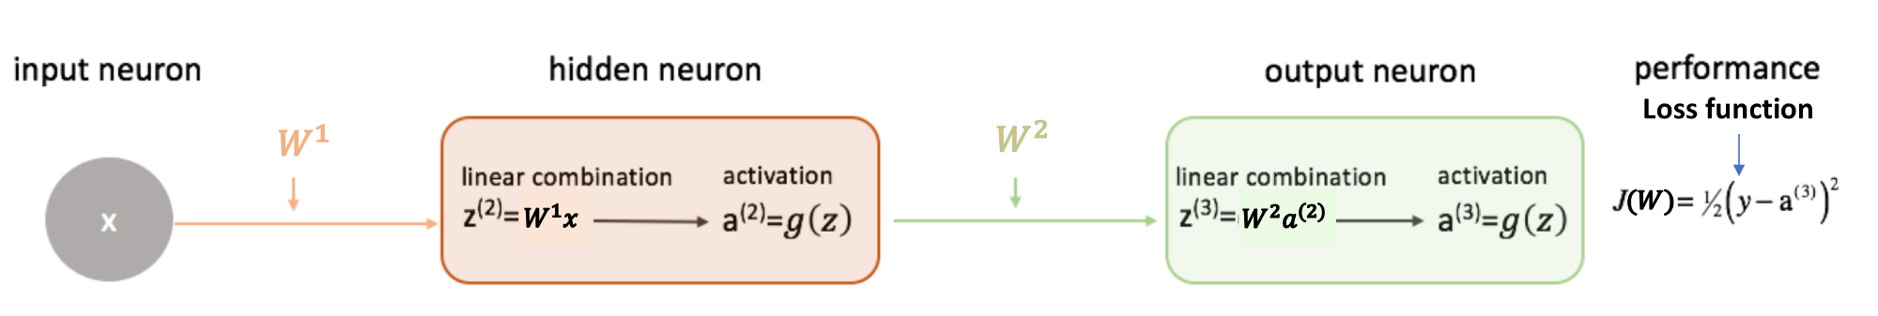
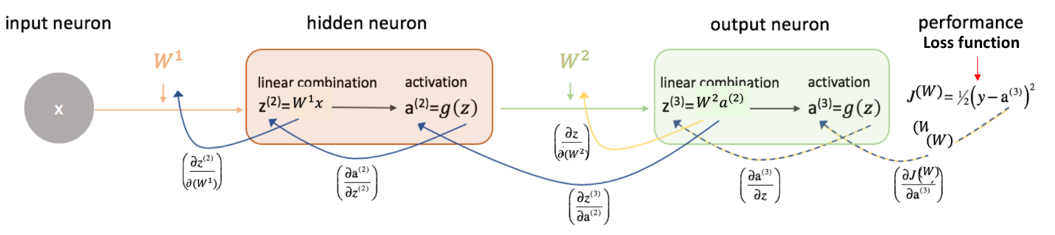
Neural Network Learning Process
As data flows through the network in the forward-propagation:
And after the loss function is calculated, we perform back-propagation to update the weights:

Slide 4
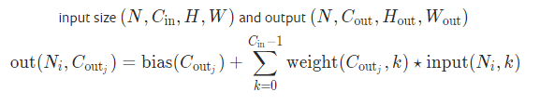
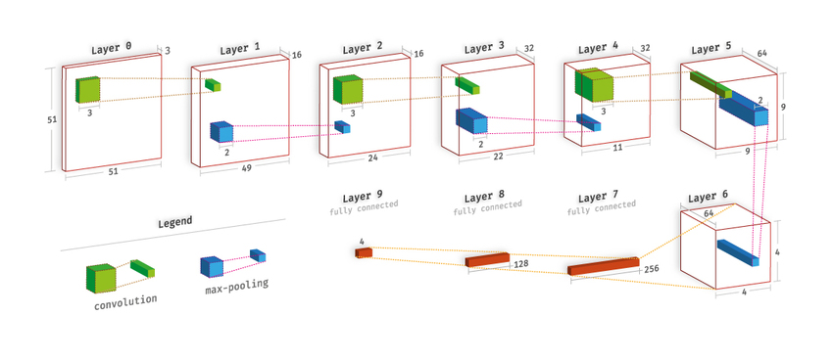
Convolutional Neural Network
A common implementation of two-dimensional convolutional layer can be described as a set of filters, and when running data thought it, each filter creates a channel in the output layer by iteration over the entire input data.
from Pytorch documentation:

Slide 5
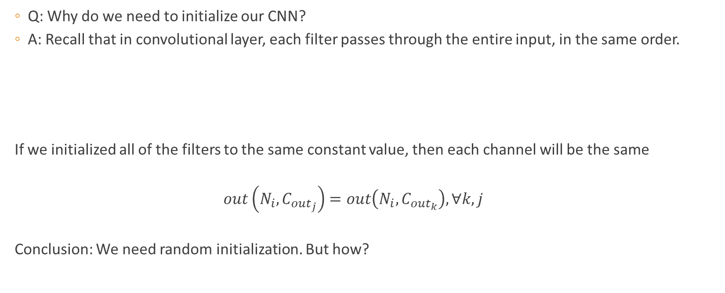
Neural Network Constant Initialization
Q: Why do we need to initialize our CNN?
A: Recall that in convolutional layer, each filter passes through the entire input, in the same order.
If we initialized all of the filters to the same constant value, then each channel will be the same
$$out\left(N_{i},C_{{out}_{j}}\right)=out\left(N_{i},C_{{out}_{k}}\right), ∀k,j$$
Conclusion: We need random initialization. But how?

Slide 6
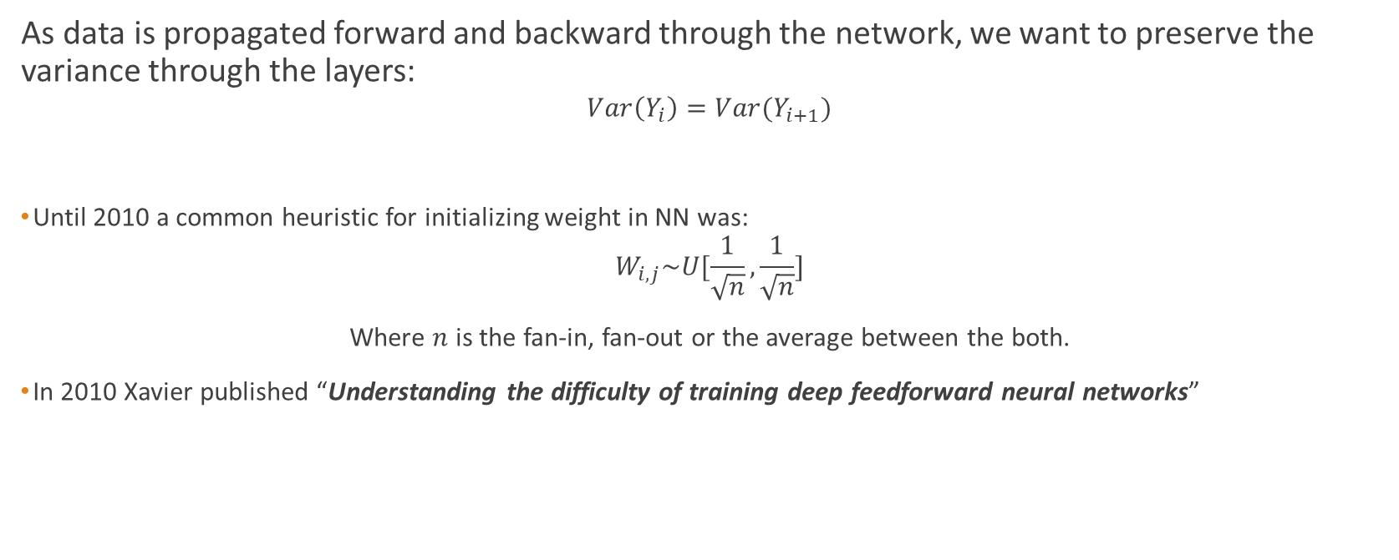
Neural Network Initialization - Properties
As data is propagated forward and backward through the network, we want to preserve the variance through the layers:
$$Var\left(Y_{i}\right)=Var(Y_{i+1})$$
Until 2010 a common heuristic for initializing weight in NN was:
$$W_{i,j}\sim U[\frac{1}{\sqrt{n}},\frac{1}{\sqrt{n}}]$$
Where $n$ is the fan-in, fan-out or the average between the both.
In 2010 Xavier published “Understanding the difficulty of training deep feedforward neural networks”

Slide 7
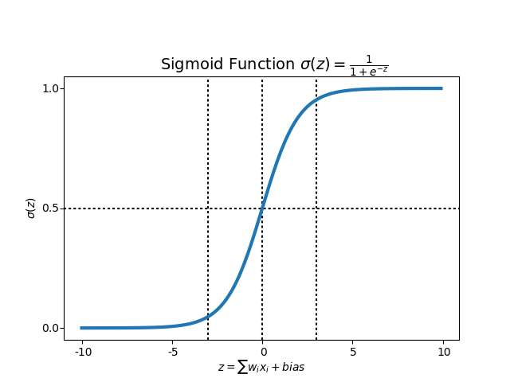
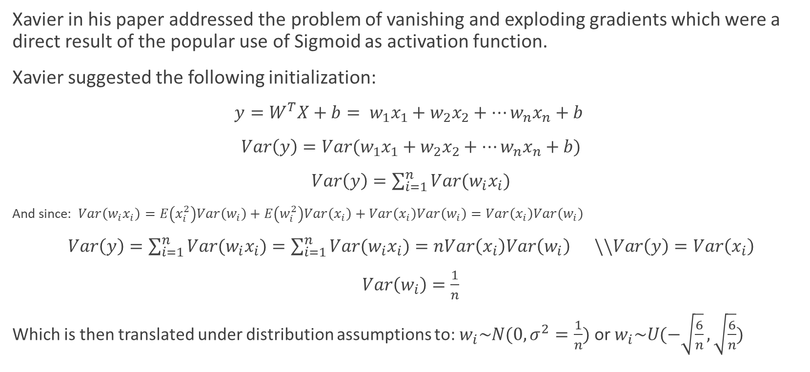
Neural Network Initialization - Xavier
Xavier in his paper addressed the problem of vanishing and exploding gradients which were a direct result of the popular use of Sigmoid as activation function.
Xavier suggested the following initialization:
$y=W^{T}X+b= w_{1}x_{1}+w_{2}x_{2}+…w_{n}x_{n}+b$
$Var\left(y\right)=Var(w_{1}x_{1}+w_{2}x_{2}+…w_{n}x_{n}+b)$
$Var\left(y\right)=\sum_{i=1}^{n}{Var(w_{i}x_{i})}$
And since: $Var\left(w_{i}x_{i}\right)=E\left(x_{i}^{2}\right)Var\left(w_{i}\right)+E\left(w_{i}^{2}\right)Var\left(x_{i}\right)+Var\left(x_{i}\right)Var\left(w_{i}\right)=Var\left(x_{i}\right)Var\left(w_{i}\right)$
$Var\left(y\right)=\sum_{i=1}^{n}{Var(w_{i}x_{i})}=\sum_{i=1}^{n}{Var(w_{i}x_{i})}=nVar\left(x_{i}\right)Var\left(w_{i}\right) \backslash \backslash Var\left(y\right)=Var\left(x_{i}\right)$
$Var\left(w_{i}\right)=\frac{1}{n}$
Which is then translated under distribution assumptions to: $w_{i}\sim N(0,σ^{2}=\frac{1}{n})$ or $w_{i}\sim U(−\sqrt{\frac{6}{n}},\sqrt{\frac{6}{n}})$

Slide 8

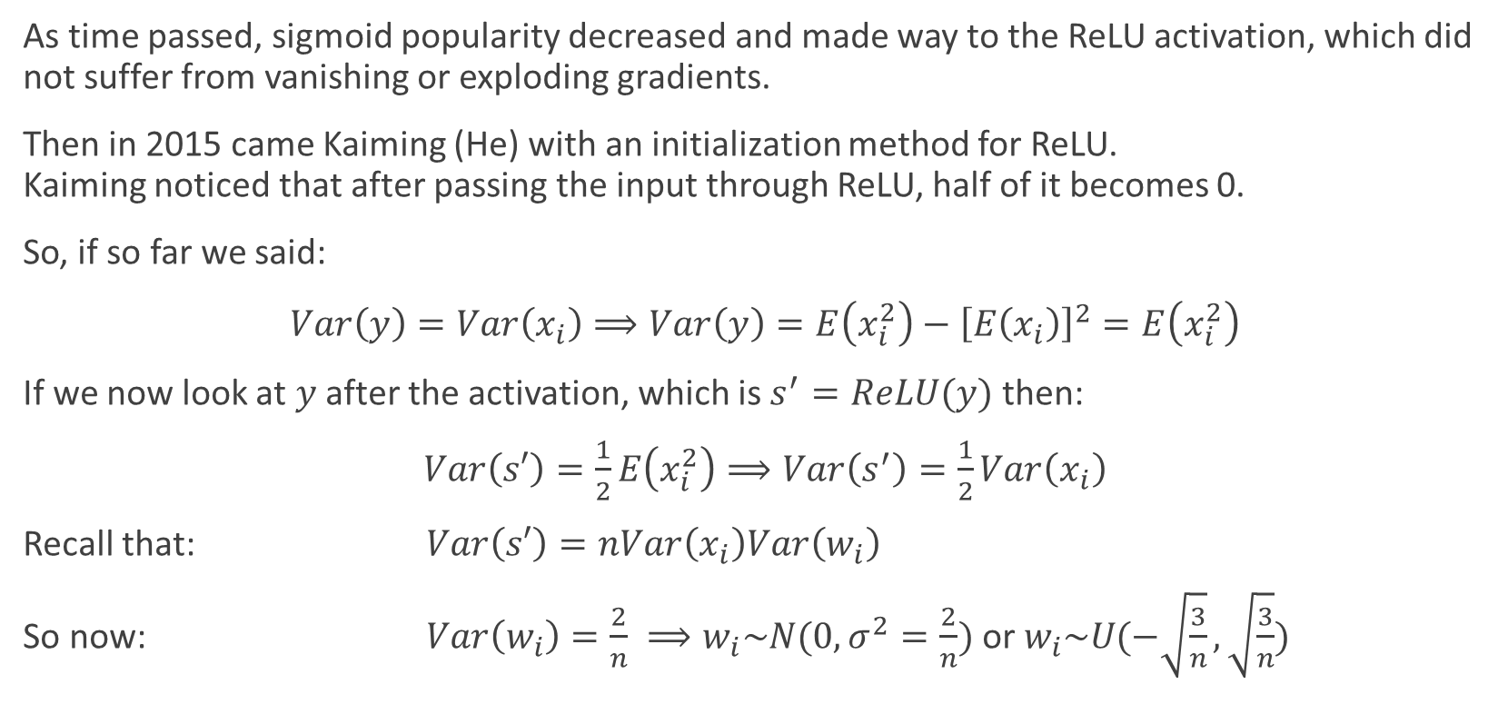
Neural Network Initialization - Kaiming
As time passed, sigmoid popularity decreased and made way to the ReLU activation, which did not suffer from vanishing or exploding gradients.
Then in 2015 came Kaiming (He) with an initialization method for ReLU. Kaiming noticed that after passing the input through ReLU, half of it becomes 0.
So, if so far we said:
$Var\left(y\right)=Var\left(x_{i}\right)⟹Var\left(y\right)=E\left(x_{i}^{2}\right)−{\left[E\left(x_{i}\right)\right]}^{2}=E\left(x_{i}^{2}\right)$
If we now look at $y$ after the activation, which is $s^{′}=ReLU(y)$ then:
$Var\left(s′\right)=\frac{1}{2}E\left(x_{i}^{2}\right)⟹Var\left(s^{′}\right)=\frac{1}{2}Var\left(x_{i}\right)$
Recall that: $Var\left(s′\right)=nVar\left(x_{i}\right)Var\left(w_{i}\right)$
So now: $Var\left(w_{i}\right)=\frac{2}{n} ⟹w_{i}\sim N(0,σ^{2}=\frac{2}{n}) \text{or} w_{i}\sim U(−\sqrt{\frac{3}{n}},\sqrt{\frac{3}{n}})$

Slide 9
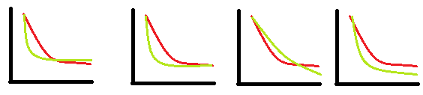
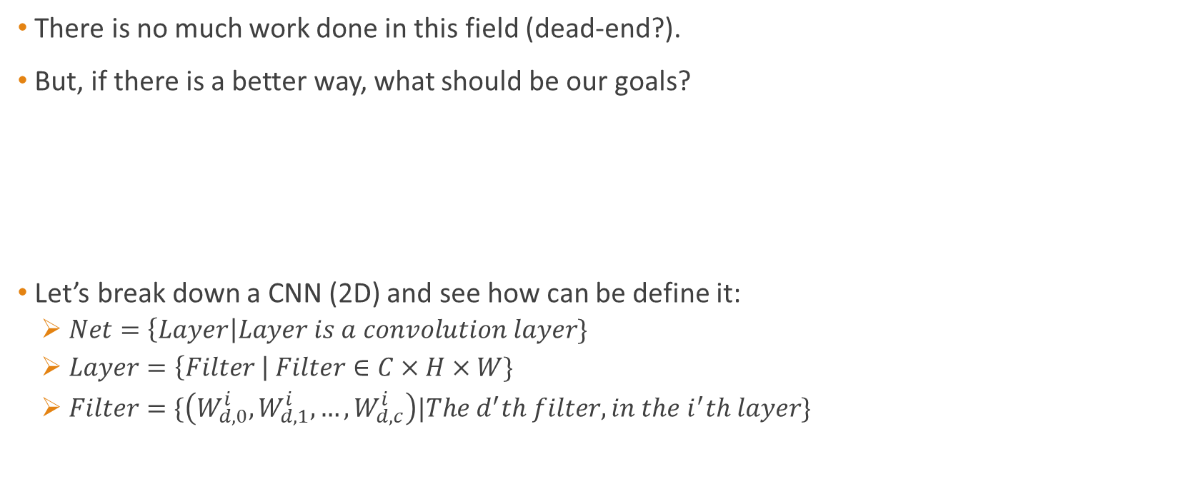
A few statements/definitions
There is no much work done in this field (dead-end?).
But, if there is a better way, what should be our goals?
Let’s break down a CNN (2D) and see how can be define it:
$Net=\left\{Layer\right|Layer is a convolution layer\}$
$Layer=\left\{Filter \right| Filter∈C×H×W\}$
$Filter=\{\left(W_{d,0}^{i},W_{d,1}^{i},…,W_{d,c}^{i}\right)|The d^{′}th filter, in the i^{′}th layer\}$

Slide 10
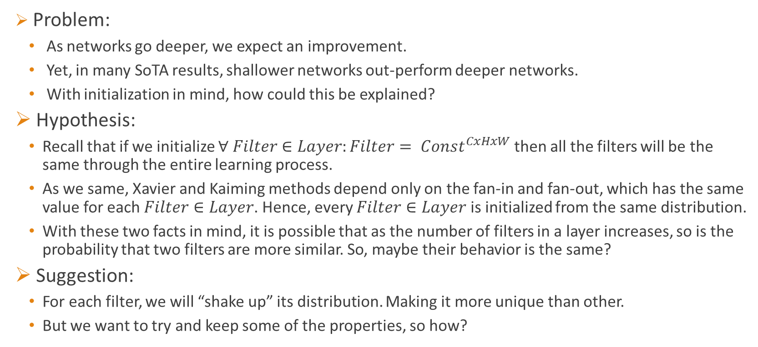
Problem and Hypothesis
Problem:
As networks go deeper, we expect an improvement.
Yet, in many SoTA results, shallower networks out-perform deeper networks.
With initialization in mind, how could this be explained?
Hypothesis:
Recall that if we initialize $∀ Filter∈Layer:Filter= {Const}^{CxHxW}$ then all the filters will be the same through the entire learning process.
As we same, Xavier and Kaiming methods depend only on the fan-in and fan-out, which has the same value for each $Filter∈Layer$. Hence, every $Filter∈Layer$ is initialized from the same distribution.
With these two facts in mind, it is possible that as the number of filters in a layer increases, so is the probability that two filters are more similar. So, maybe their behavior is the same?
Suggestion:
For each filter, we will “shake up” its distribution. Making it more unique than other.
But we want to try and keep some of the properties, so how?

Slide 11
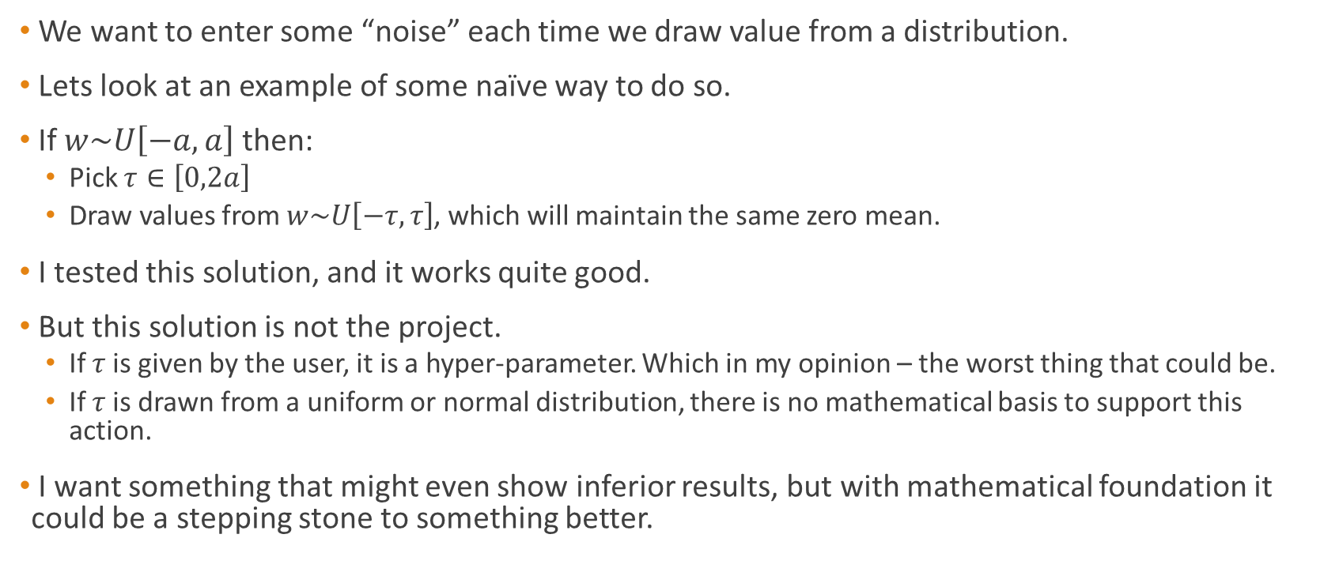
Naïve solution
We want to enter some “noise” each time we draw value from a distribution.
Lets look at an example of some naïve way to do so.
If $w\sim U\left[−a,a\right]$ then:
Pick $τ∈\left[0,2a\right]$
Draw values from $w\sim U\left[−τ,τ\right]$, which will maintain the same zero mean.
I tested this solution, and it works quite good.
But this solution is not the project.
If $τ$is given by the user, it is a hyper-parameter. Which in my opinion – the worst thing that could be.
If $τ$is drawn from a uniform or normal distribution, there is no mathematical basis to support this action.
I want something that might even show inferior results, but with mathematical foundation it could be a stepping stone to something better.

Slide 12
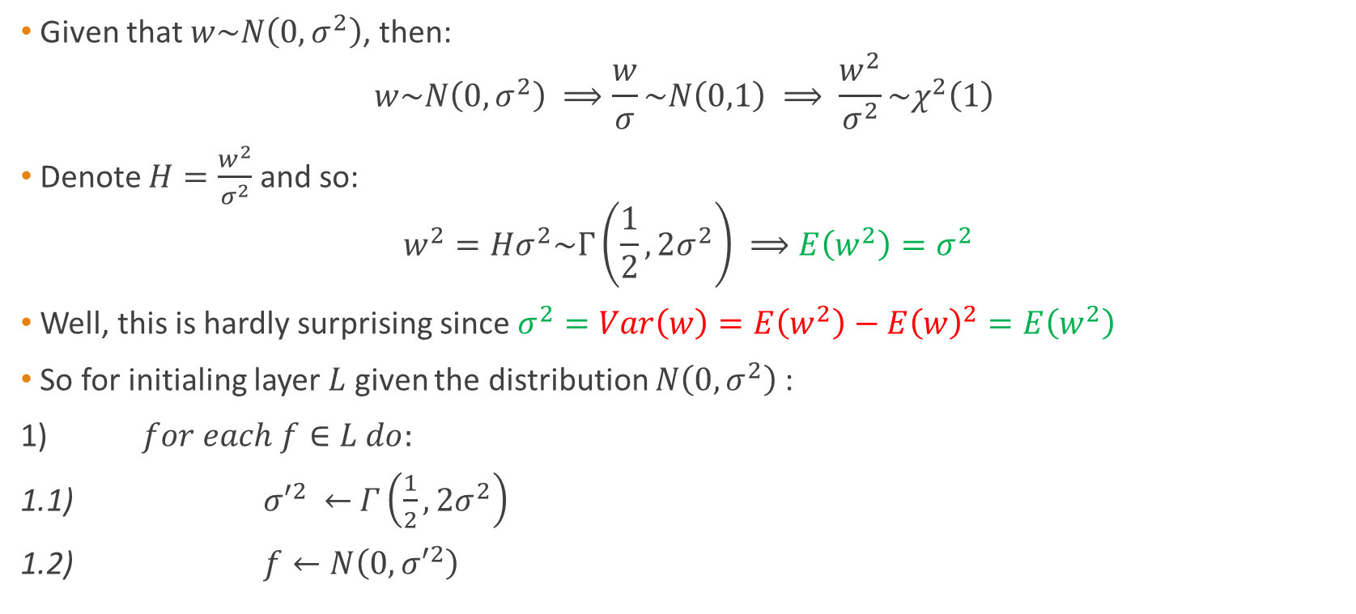
My suggestion – normal case
Given that $w\sim N\left(0,σ^{2}\right)$, then:
$$w\sim N\left(0,σ^{2}\right) ⟹\frac{w}{σ}\sim N\left(0,1\right) ⟹ \frac{w^{2}}{σ^{2}}\sim χ^{2}\left(1\right)$$
Denote $H=\frac{w^{2}}{σ^{2}}$ and so:
$$w^{2}=Hσ^{2}\sim Γ\left(\frac{1}{2}, 2σ^{2}\right) ⟹E\left(w^{2}\right)=σ^{2}$$
Well, this is hardly surprising since $σ^{2}=Var\left(w\right)=E\left(w^{2}\right)−{E\left(w\right)}^{2}=E\left(w^{2}\right)$
So for initialing layer $L$ given the distribution $N\left(0,σ^{2}\right)$:
1) $for each f∈L do:$
1.1) ${σ′}^{2} ←$ $Γ\left(\frac{1}{2}, 2σ^{2}\right)$
1.2) $f←N\left(0,{σ′}^{2}\right)$

Slide 13
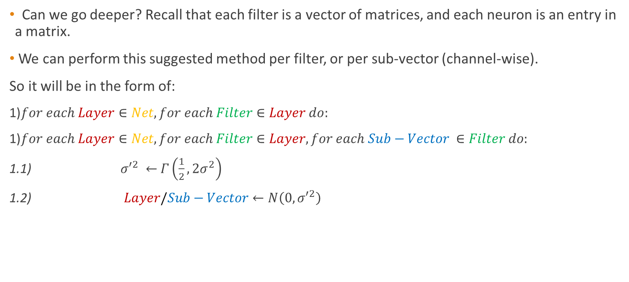
My suggestion – normal case
Can we go deeper? Recall that each filter is a vector of matrices, and each neuron is an entry in a matrix.
We can perform this suggested method per filter, or per sub-vector (channel-wise).
So it will be in the form of:
1)$for each Layer∈Net, for each Filter∈Layer do:$
1)$for each Layer∈Net, for each Filter∈Layer, for each Sub−Vector ∈Filter do:$
1.1) ${σ′}^{2} ←$ $Γ\left(\frac{1}{2}, 2σ^{2}\right)$
1.2) $Layer/Sub−Vector←N\left(0,{σ′}^{2}\right)$

Slide 14
My suggestion – normal case – so far…
So far we saw how to randomly draw the variance of our given distribution and generate a new distribution out of it.
We also saw how this could be applied in different dimensions of our neural network
But how does it looks like? Let’s look at the first convolution layer of ResNet110

Slide 15
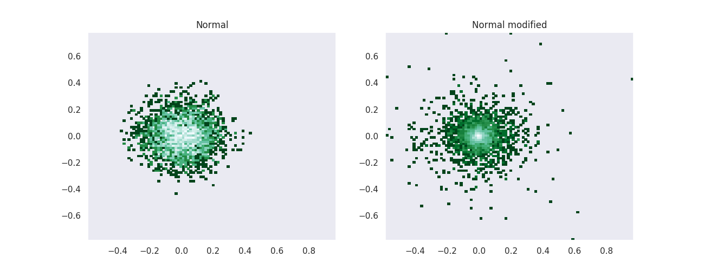
My suggestion – normal case – 2D hist
plots of the first convolution layer in ResNet-110, with 64 filters, each of dimension 3x7x7. Each row in the channel dimension in each filter is a sample, totaling in 49*64=3169. Logarithm applied for visualization.

Slide 16
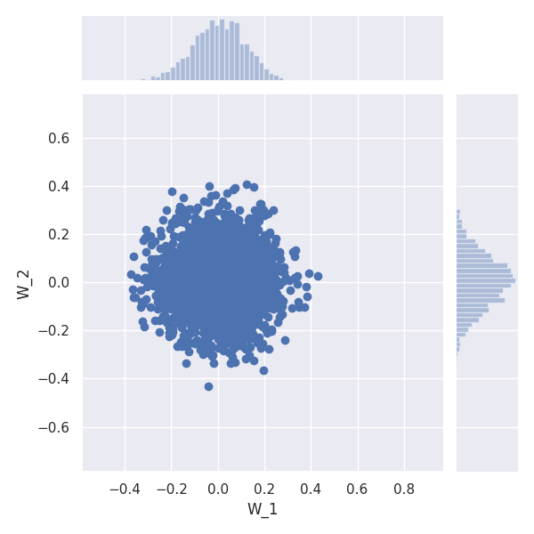
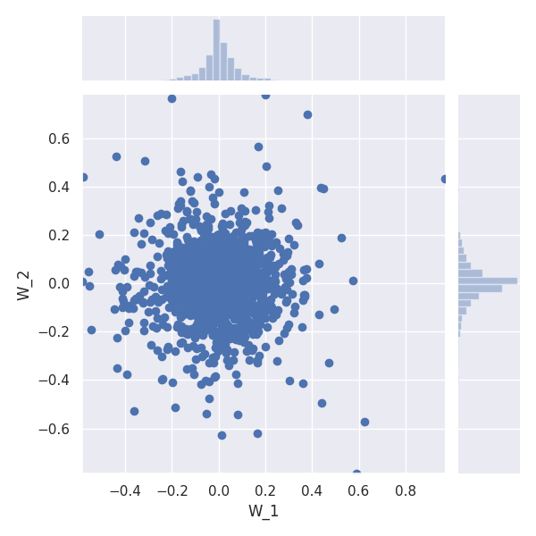
My suggestion – normal case – 2D Scatter
plots of the first convolution layer in ResNet-110, with 64 filters, each of dimension 3x7x7. Each row in the channel dimension in each filter is a sample, totaling in 49*64=3169. Logarithm applied for visualization.
Normal
Normal modified

Slide 17
My suggestion – normal case - Results
Results are based on an official implementation of a SoTA article called "Random Erasing Data Augmentation“.
Some Results are shown as ratio between suggested method and baseline (Kaiming).

Slide 18
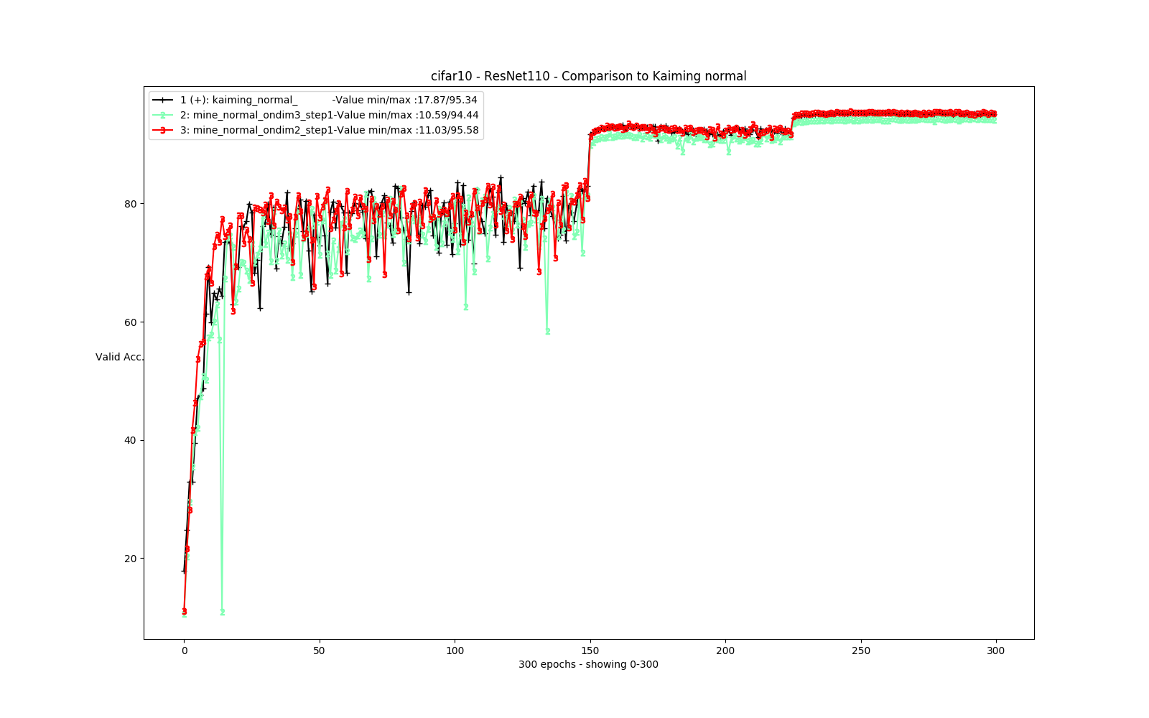
My suggestion – normal case - Results

Slide 19
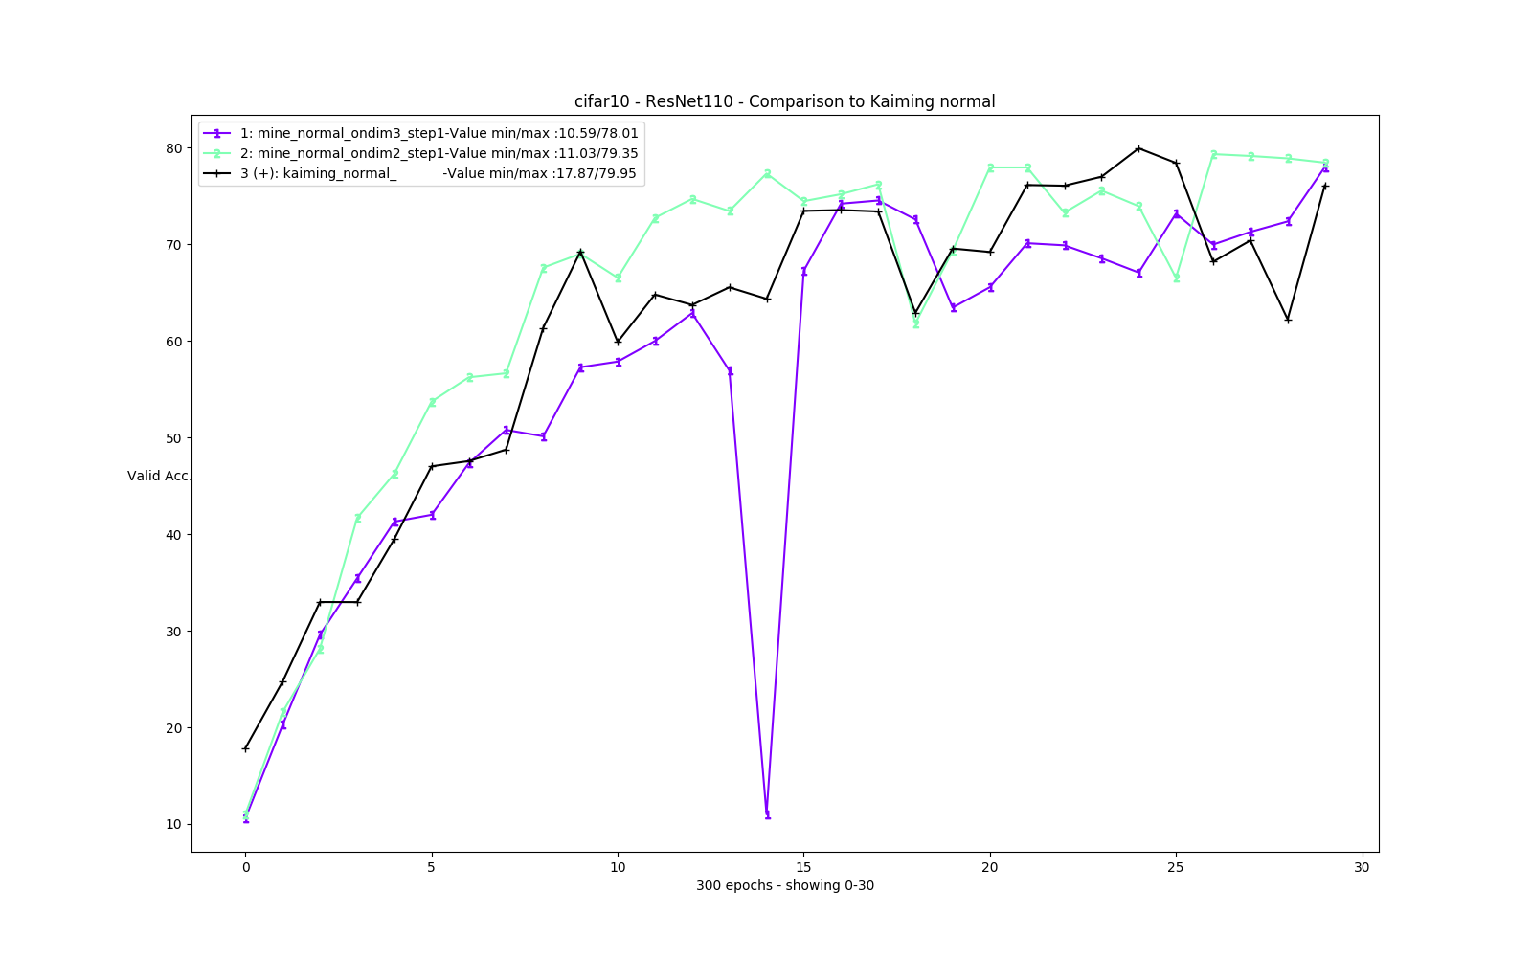
My suggestion – normal case - Results

Slide 20
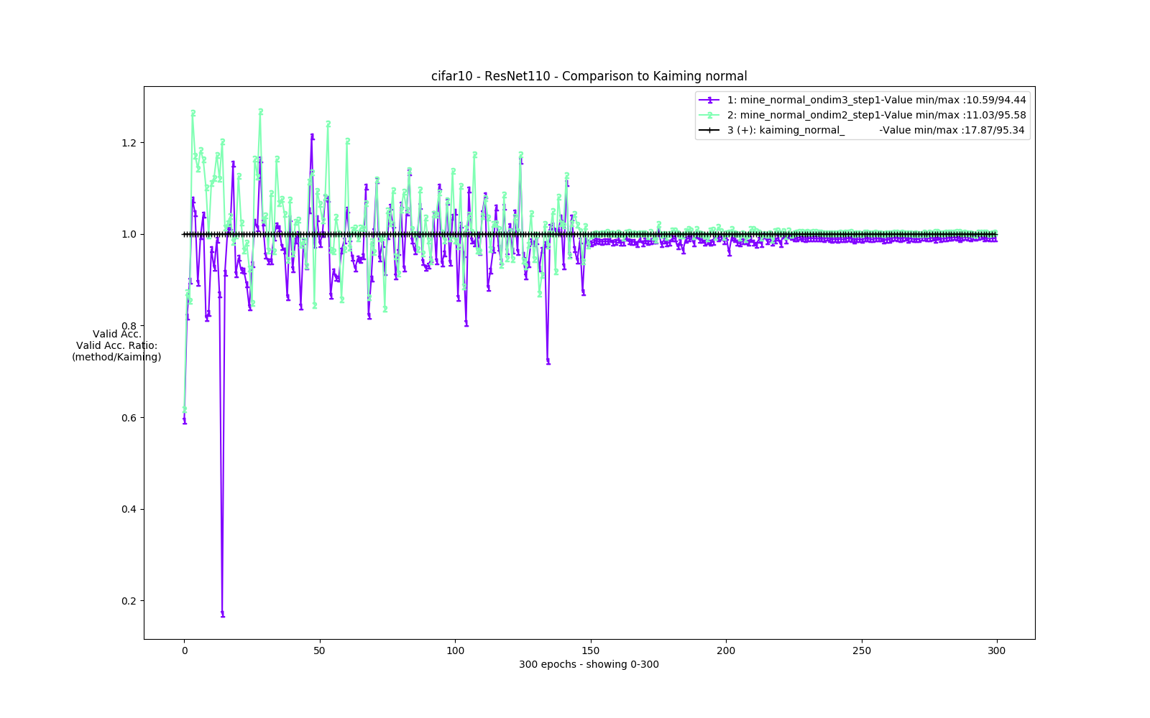
My suggestion – normal case - Results

Slide 21
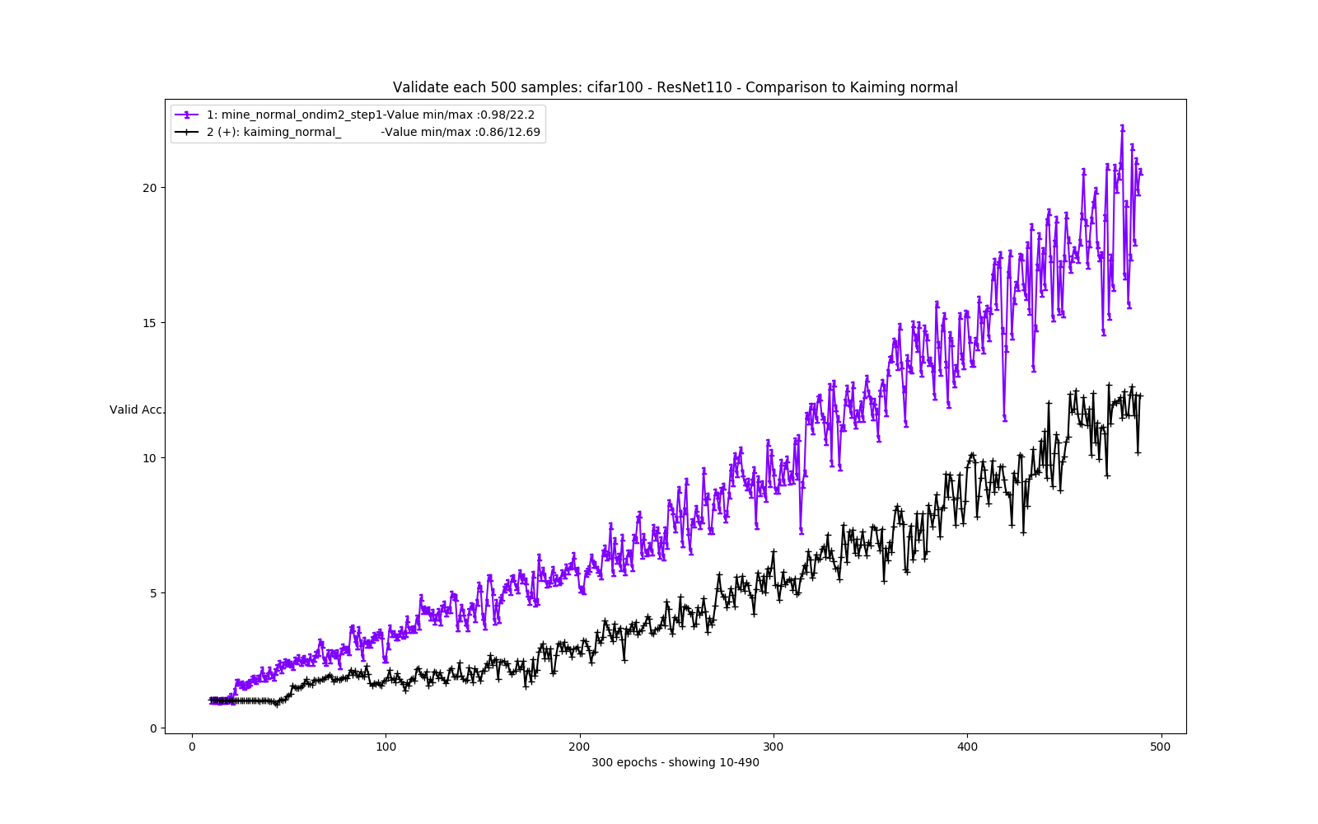
My suggestion – normal case - Results

Slide 22
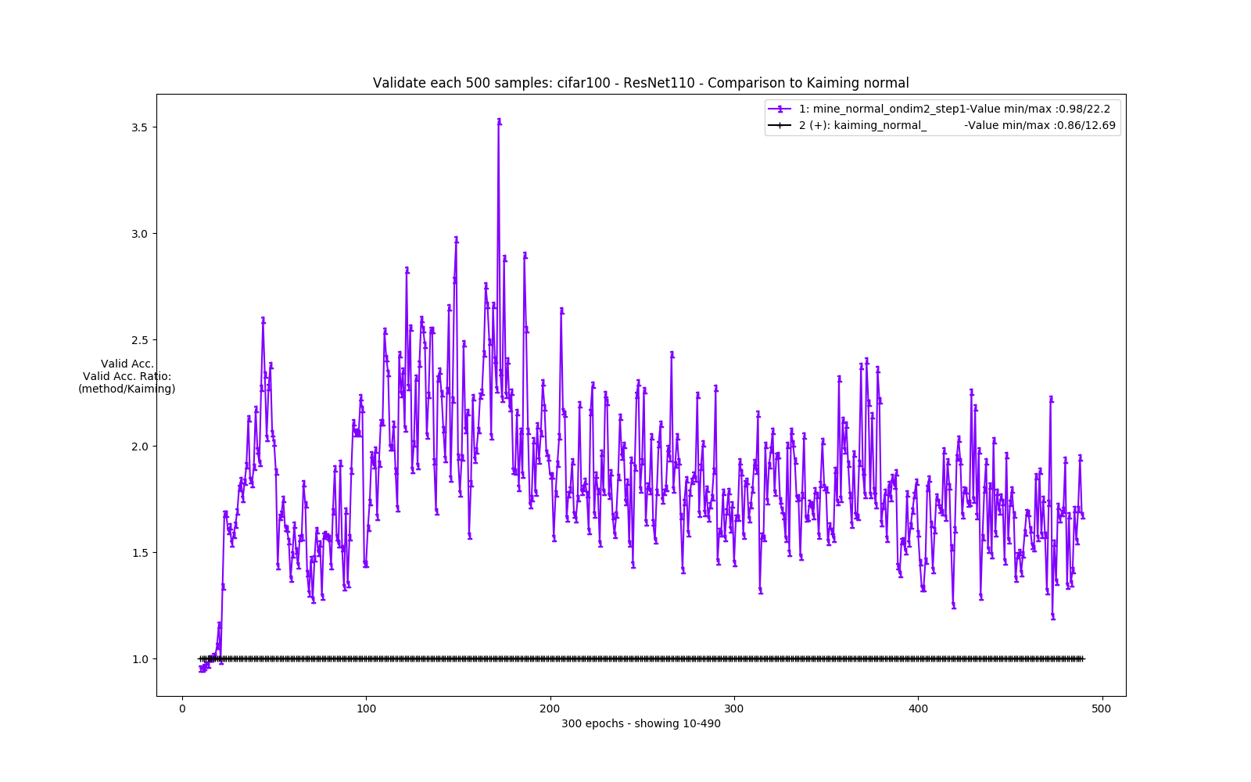
My suggestion – normal case - Results

Slide 23
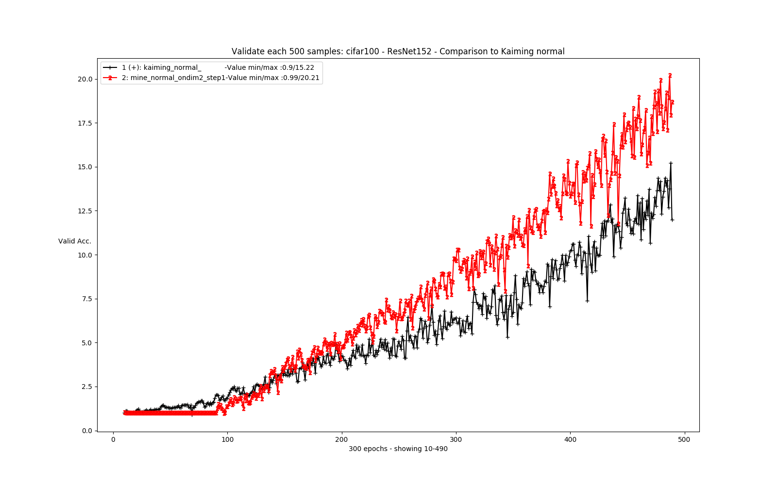
My suggestion – normal case - Results

Slide 24
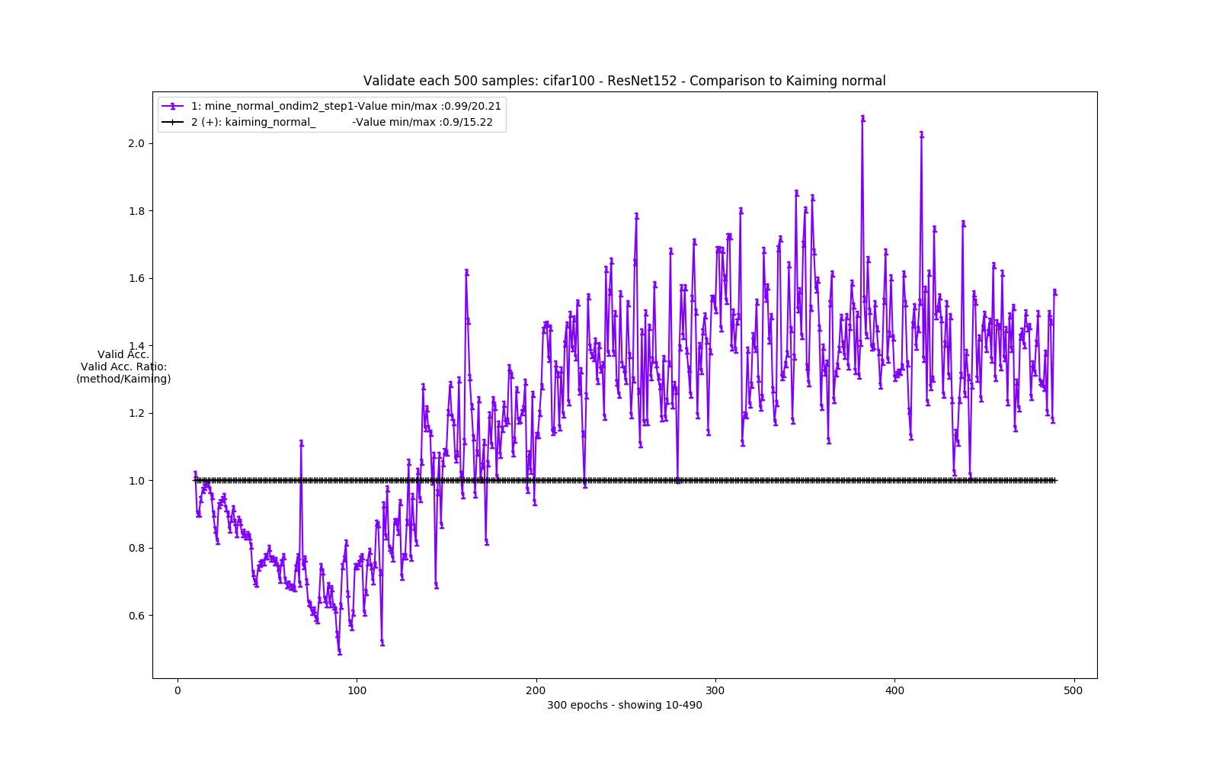
My suggestion – normal case - Results

Slide 25
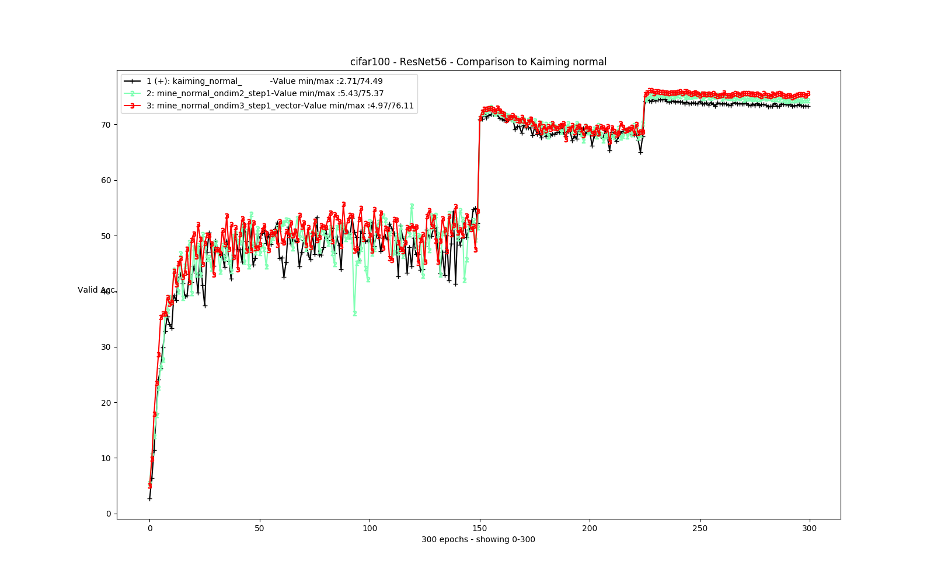
My suggestion – normal case - Results

Slide 26
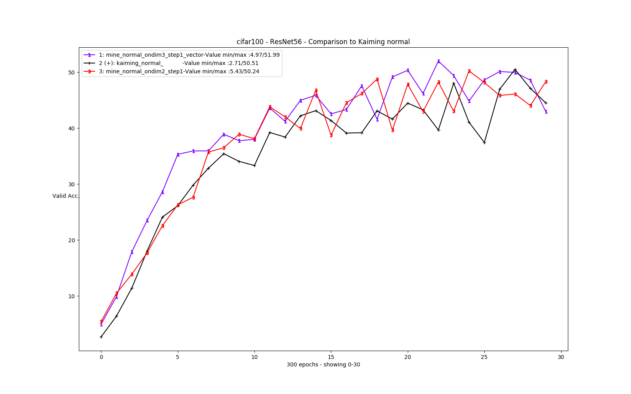
My suggestion – normal case - Results

Slide 27
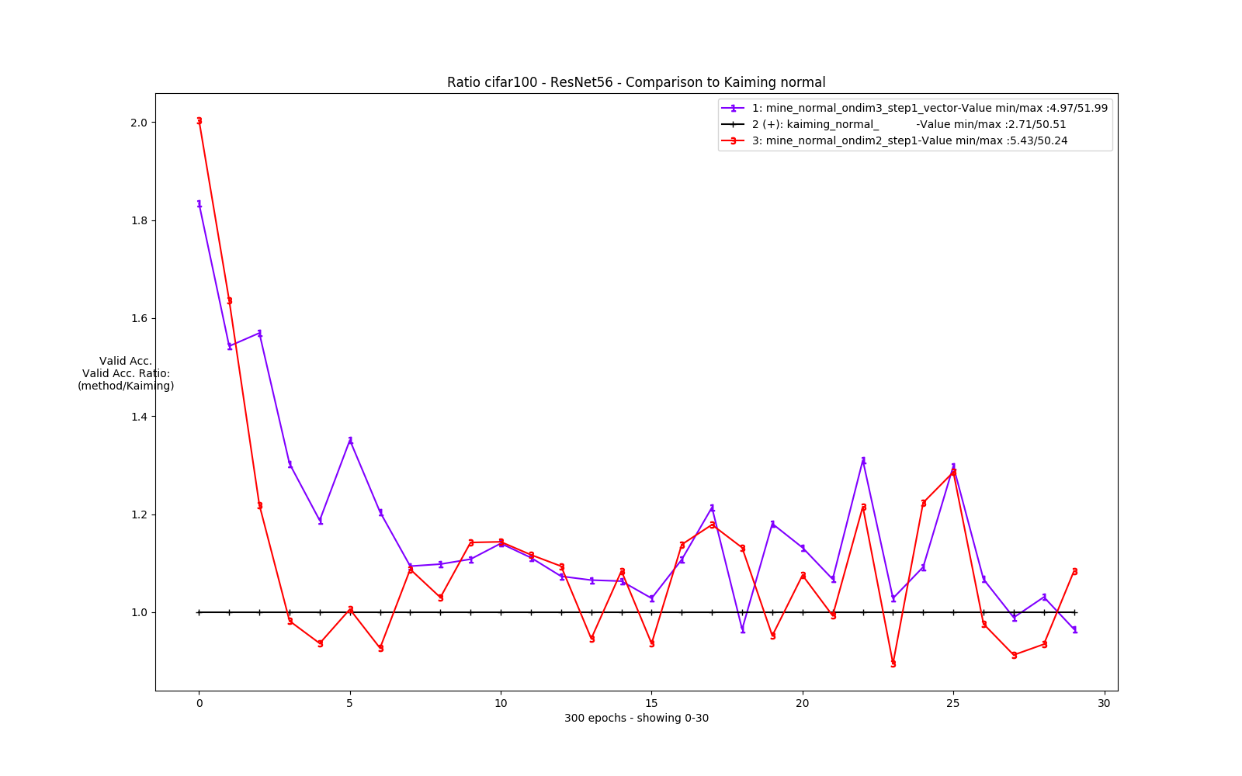
My suggestion – normal case - Results

Slide 28
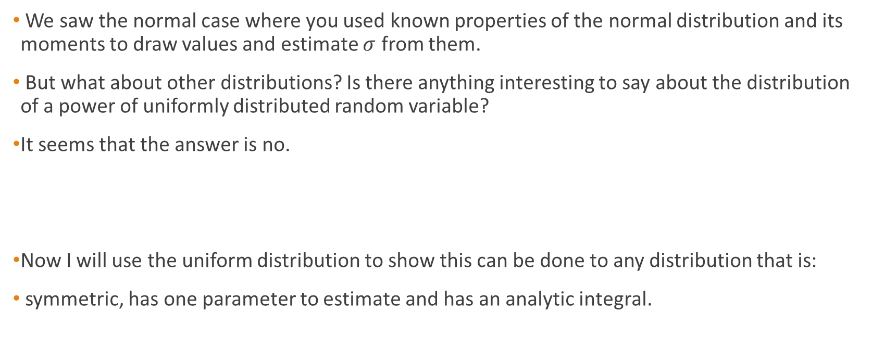
My suggestion – uniform as general case
We saw the normal case where you used known properties of the normal distribution and its moments to draw values and estimate $σ$ from them.
But what about other distributions? Is there anything interesting to say about the distribution of a power of uniformly distributed random variable?
It seems that the answer is no.
Now I will use the uniform distribution to show this can be done to any distribution that is:
symmetric, has one parameter to estimate and has an analytic integral.

Slide 29
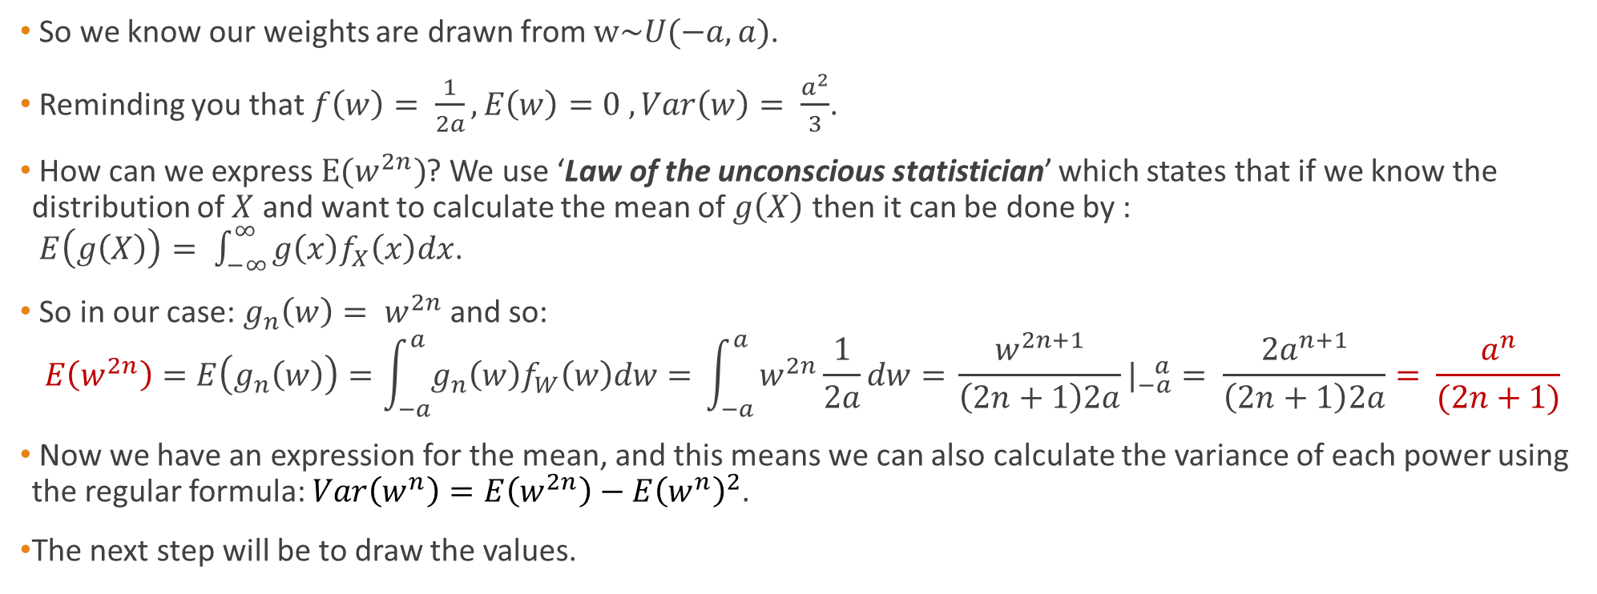
My suggestion – uniform as general case
So we know our weights are drawn from $w\sim U(−a,a)$.
Reminding you that $f\left(w\right)= \frac{1}{2a}, E\left(w\right)=0 , Var\left(w\right)= \frac{a^{2}}{3}$.
How can we express $E(w^{2n})$? We use ‘Law of the unconscious statistician’ which states that if we know the distribution of $X$ and want to calculate the mean of $g\left(X\right)$ then it can be done by : $E\left(g\left(X\right)\right)= \int_{−∞}^{∞}{g\left(x\right)f_{X}\left(x\right)dx}$.
So in our case: $g_{n}\left(w\right)= w^{2n}$and so:
$$E\left(w^{2n}\right)=E\left(g_{n}\left(w\right)\right)=\int_{−a}^{a}{g_{n}\left(w\right)f_{W}\left(w\right)dw= }\int_{−a}^{a}{w^{2n}\frac{1}{2a}dw= }\frac{w^{2n+1}}{\left(2n+1\right)2a}|_{−a}^{ a}= \frac{{2a}^{n+1}}{\left(2n+1\right)2a}= \frac{a^{n}}{(2n+1)}$$
Now we have an expression for the mean, and this means we can also calculate the variance of each power using the regular formula: $Var\left(w^{n}\right)=E\left(w^{2n}\right)−{E\left(w^{n}\right)}^{2}$.
The next step will be to draw the values.

Slide 30
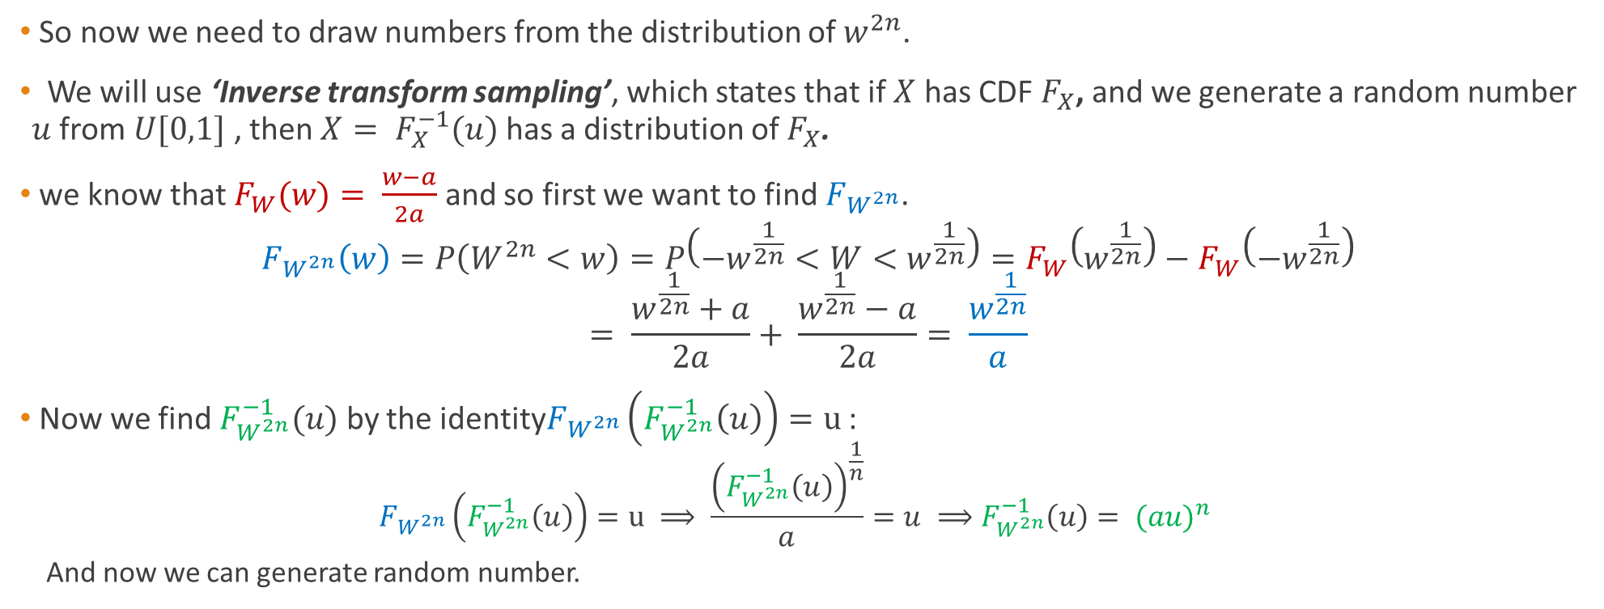
My suggestion – uniform as general case
So now we need to draw numbers from the distribution of $w^{2n}$.
We will use ‘Inverse transform sampling’, which states that if $X$ has CDF $F_{X}$, and we generate a random number $u$ from $U[0,1]$ , then $X= F_{X}^{−1}(u)$ has a distribution of $F_{X}$.
we know that $F_{W}(w)= \frac{w−a}{2a}$ and so first we want to find $F_{W^{2n}}$.
$$F_{W^{2n}}\left(w\right)=P\left(W^{2n}<w\right)=P\left(−w^{\frac{1}{2n}}<W<w^{\frac{1}{2n}}\right)=F_{W}\left(w^{\frac{1}{2n}}\right)−F_{W}\left(−w^{\frac{1}{2n}}\right) \\ = \frac{w^{\frac{1}{2n}}+a}{2a}+ \frac{w^{\frac{1}{2n}}−a}{2a}= \frac{w^{\frac{1}{2n}}}{a}$$
Now we find $F_{W^{2n}}^{−1}(u)$ by the identity$F_{W^{2n}}\left(F_{W^{2n}}^{−1}\left(u\right)\right)=u$ :
$$F_{W^{2n}}\left(F_{W^{2n}}^{−1}\left(u\right)\right)=u ⟹ \frac{{\left(F_{W^{2n}}^{−1}\left(u\right)\right)}^{\frac{1}{n}}}{a}=u ⟹F_{W^{2n}}^{−1}\left(u\right)= {(au)}^{n}$$
And now we can generate random number.

Slide 31
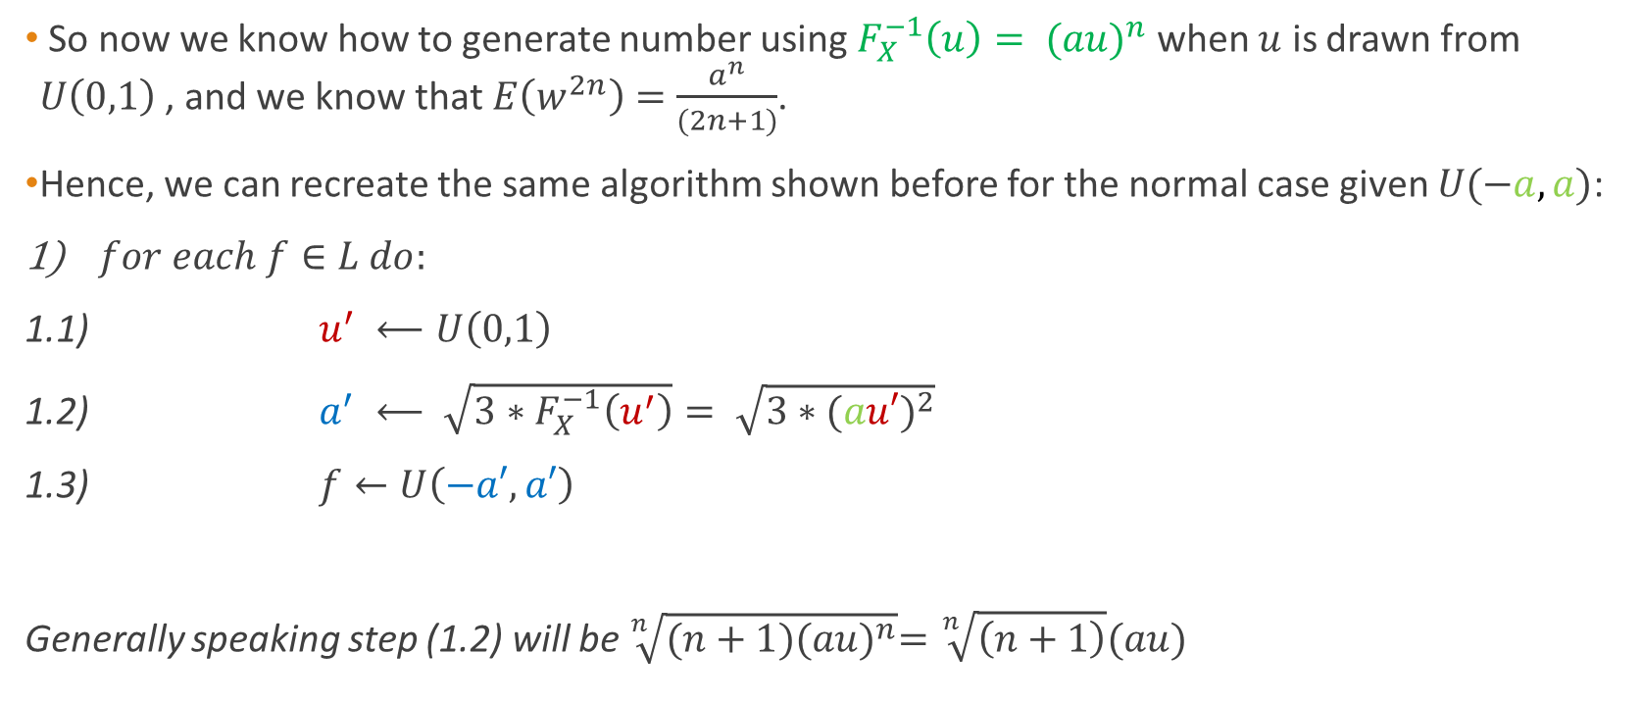
My suggestion – uniform as general case
So now we know how to generate number using $F_{X}^{−1}\left(u\right)= {(au)}^{n}$ when $u$ is drawn from $U\left(0,1\right)$ , and we know that $E\left(w^{2n}\right)=$ $\frac{a^{n}}{(2n+1)}$.
Hence, we can recreate the same algorithm shown before for the normal case given $U(−a,a)$:
$for each f∈L do:$
1.1) $u^{′} ⟵U\left(0,1\right)$
1.2) $a^{′} ⟵ \sqrt{3∗F_{X}^{−1}\left(u^{′}\right)}= \sqrt{3∗{(au′)}^{2}}$
1.3) $f←U\left(−a′,a′\right)$
Generally speaking step (1.2) will be $\sqrt[n]{(n+1){(au)}^{n}}=\sqrt[n]{\left(n+1\right)}(au)$

Slide 32
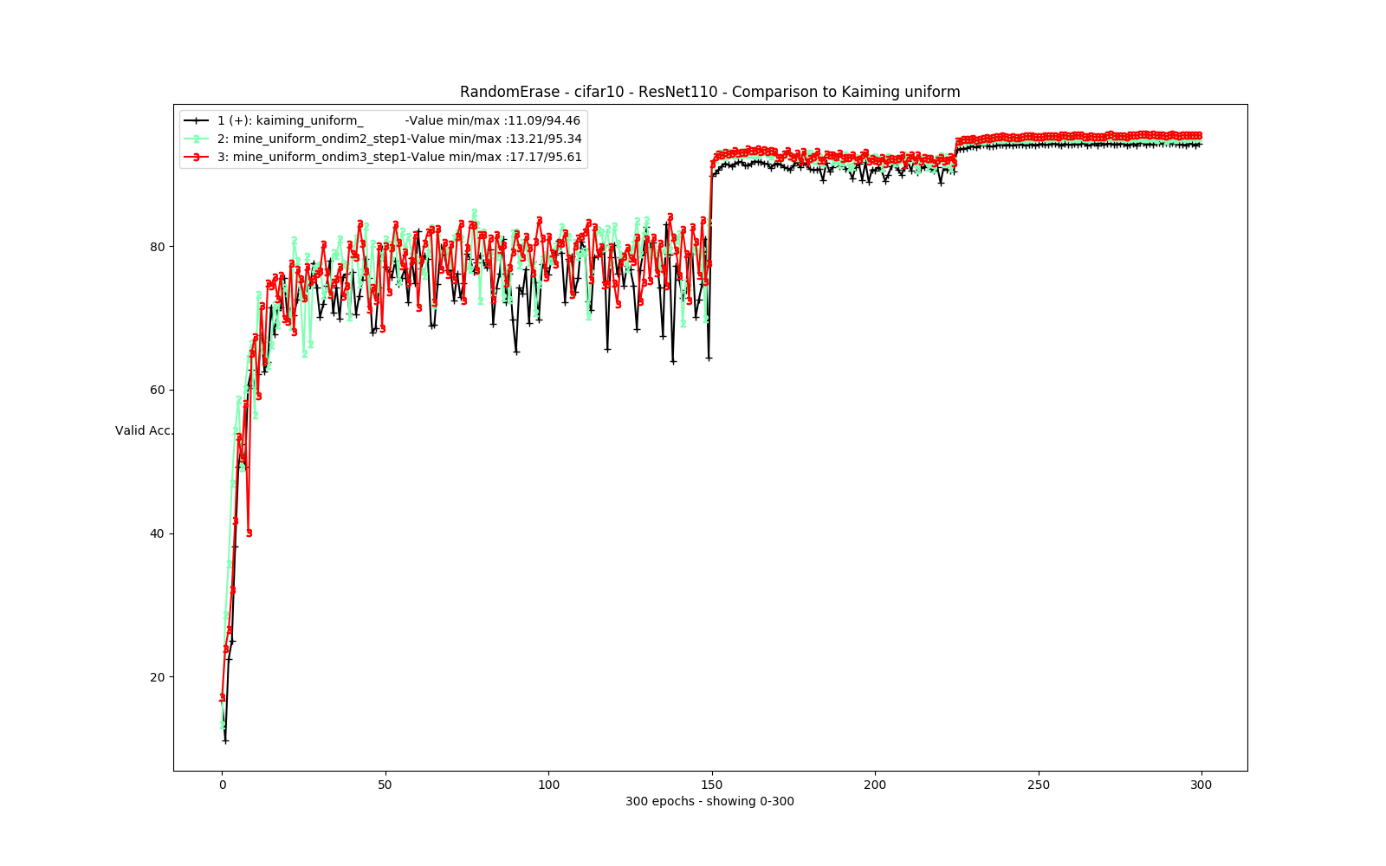
My suggestion – uniform - Results

Slide 33
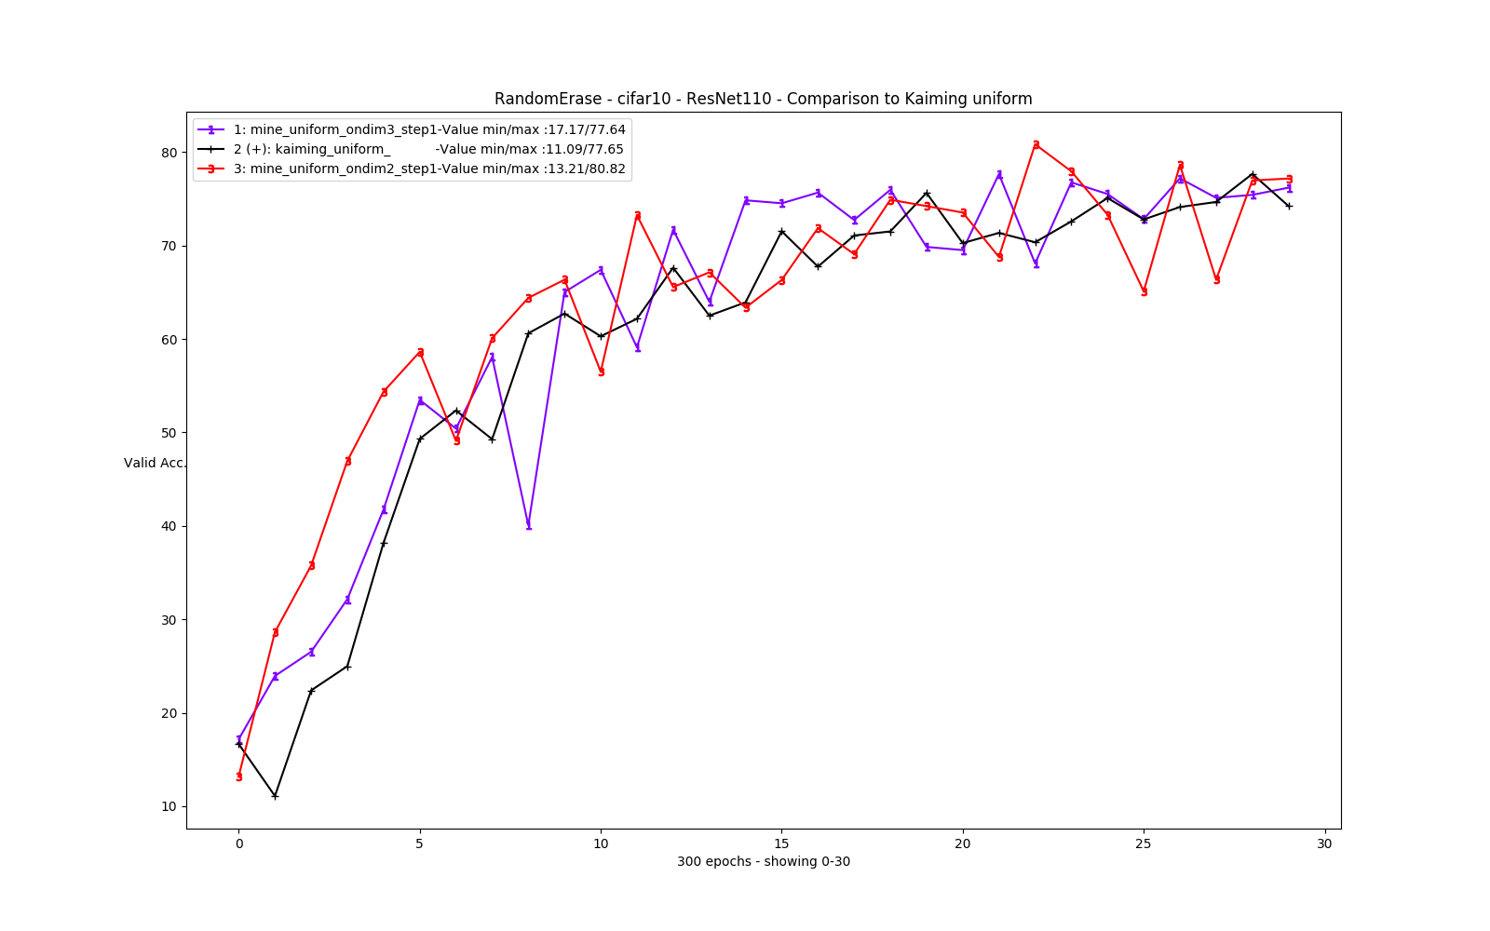
My suggestion – uniform - Results

Slide 34
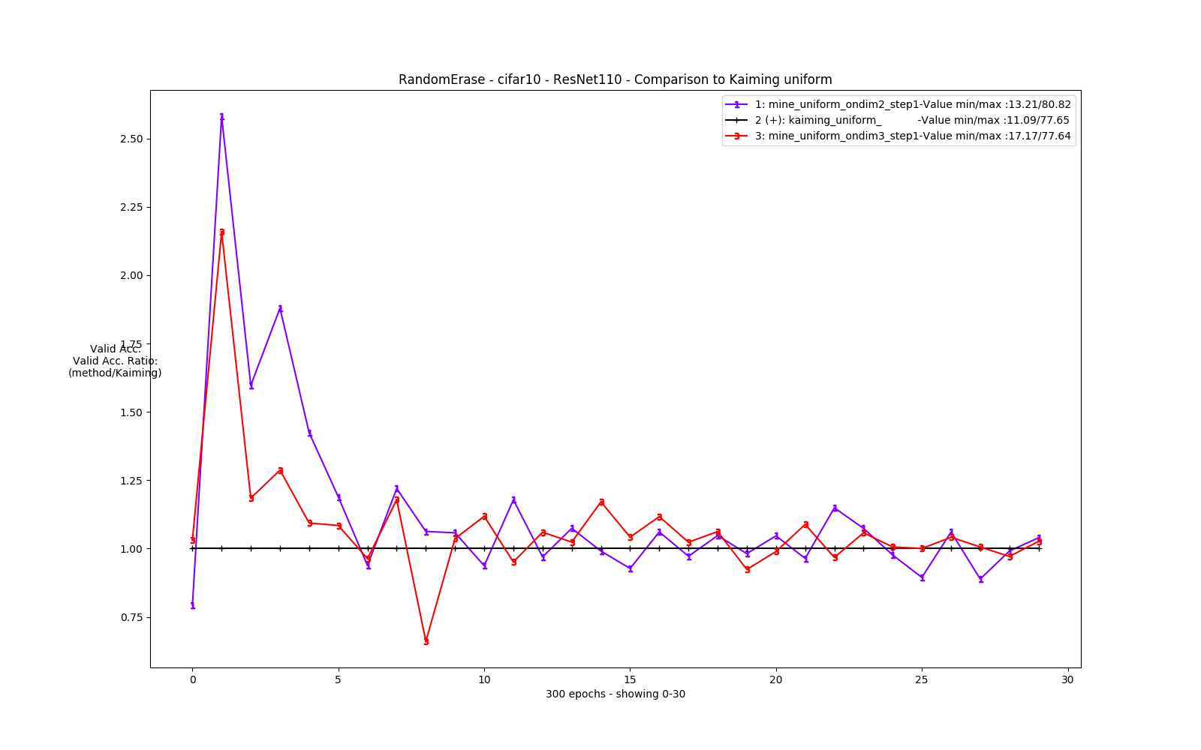
My suggestion – uniform - Results

Slide 35
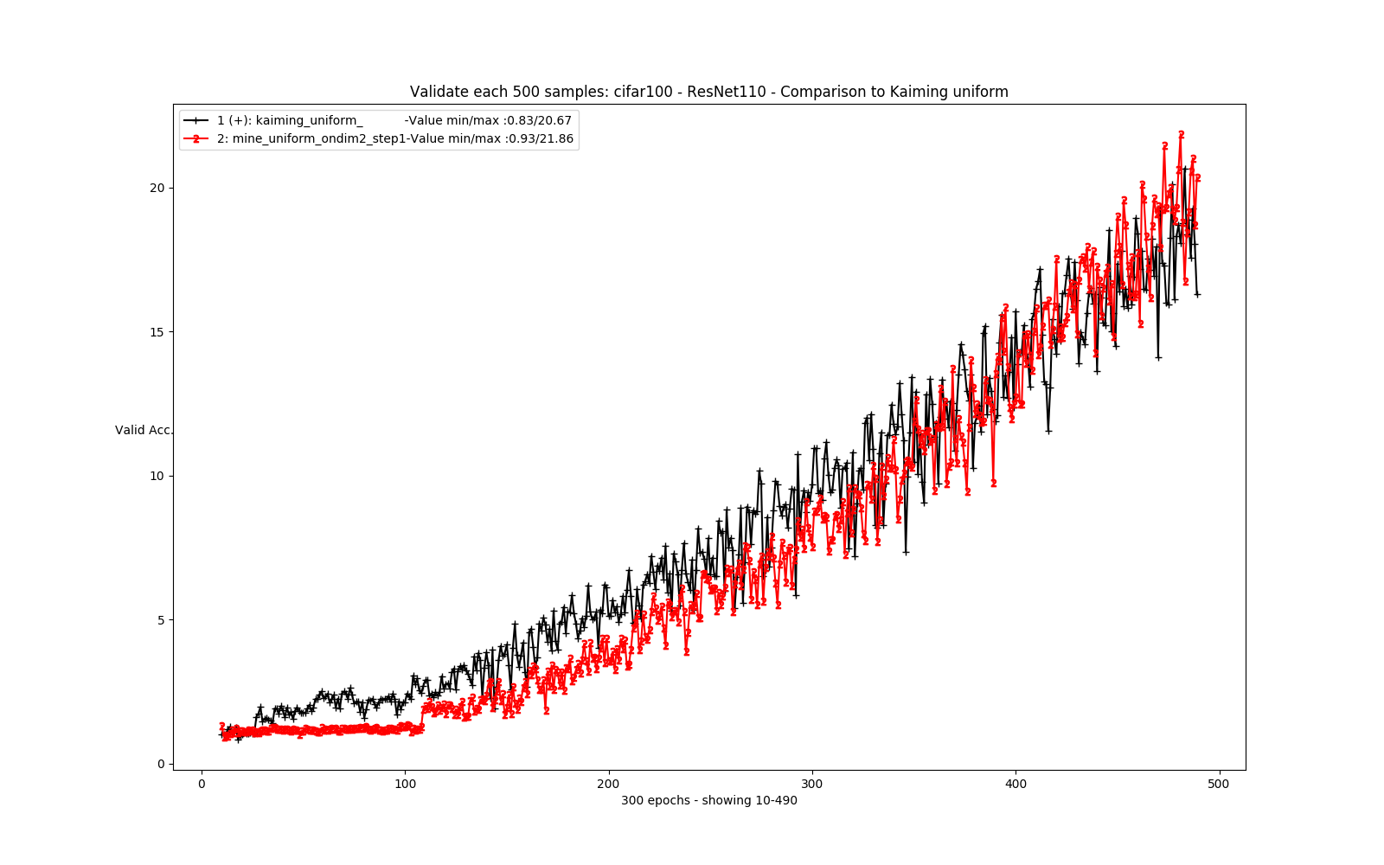
My suggestion – uniform - Results

Slide 36
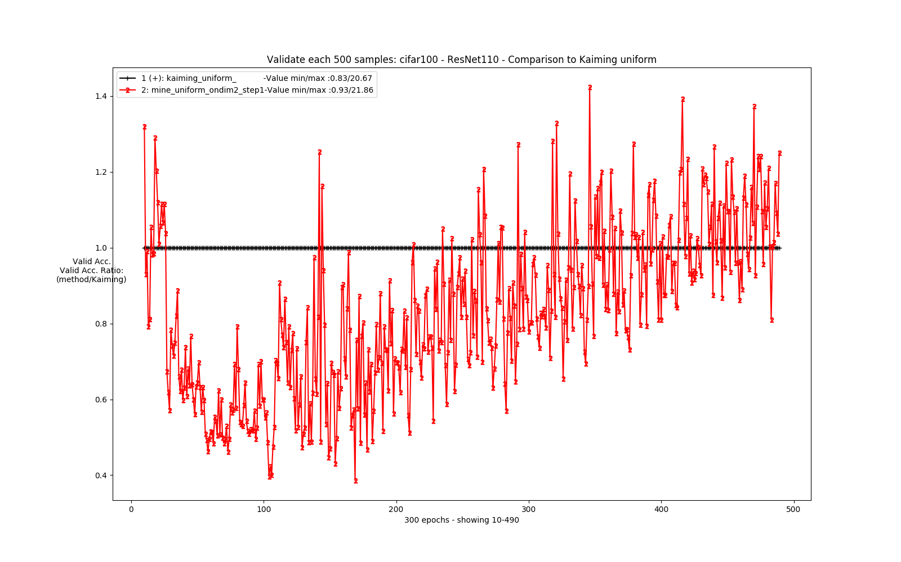
My suggestion – uniform - Results

Slide 37
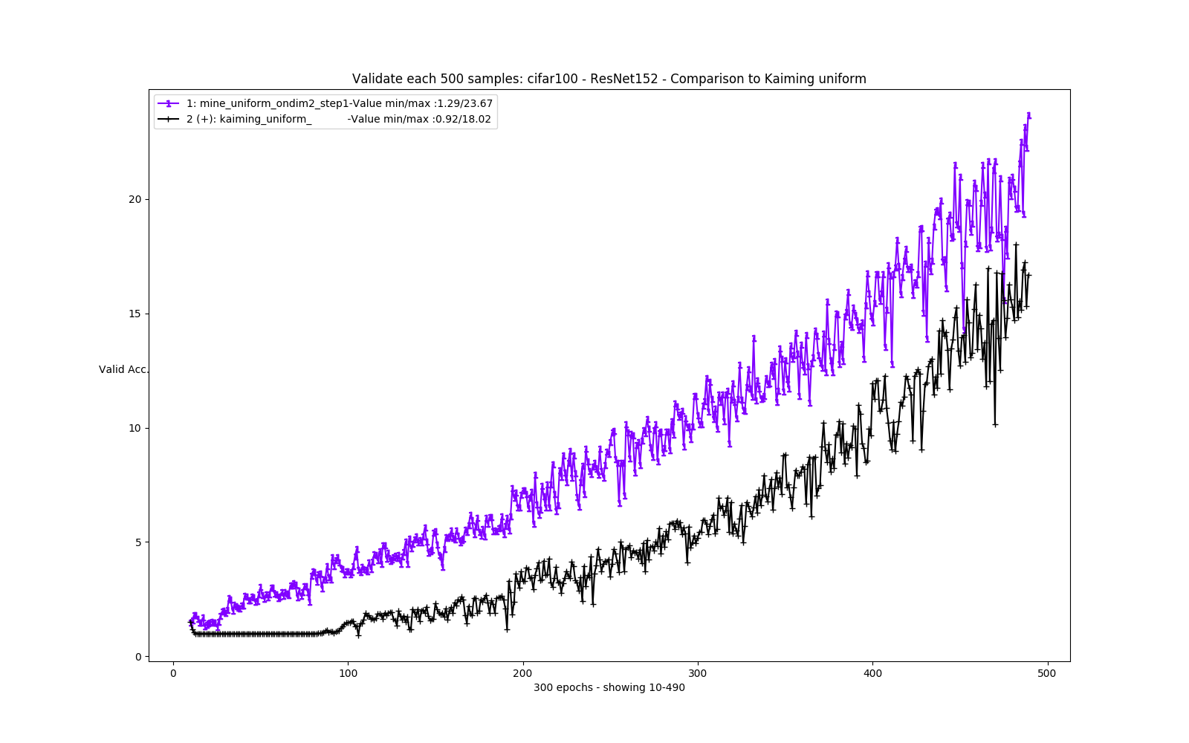
My suggestion – uniform - Results

Slide 38
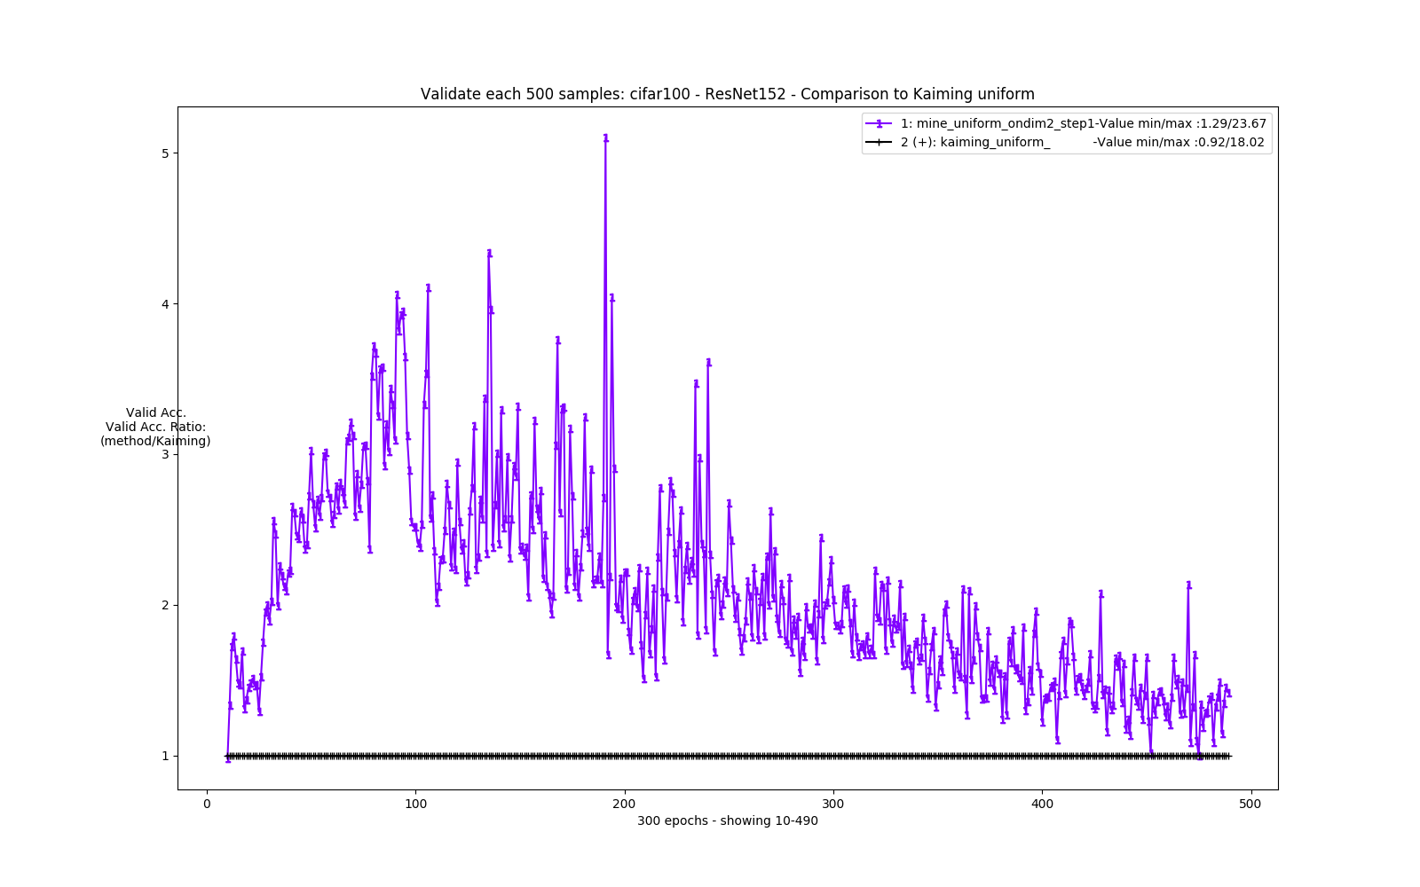
My suggestion – uniform - Results

Slide 39
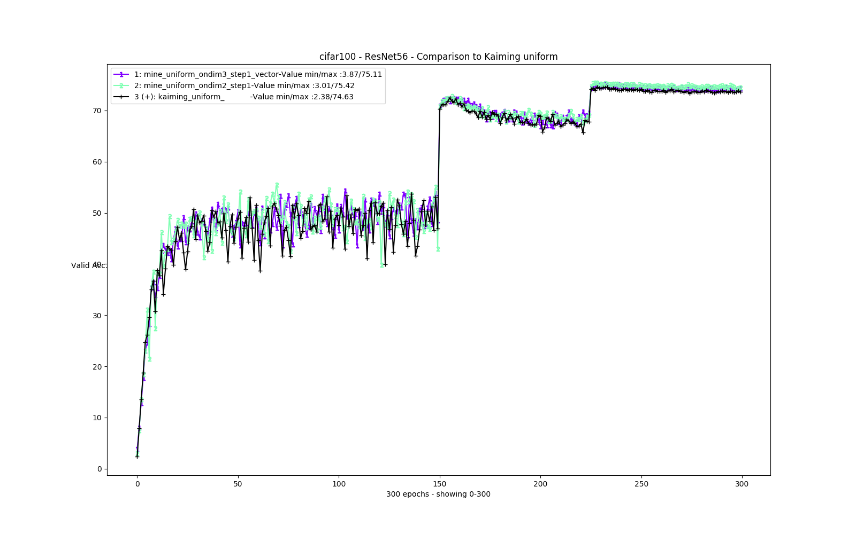
My suggestion – uniform - Results

Slide 40
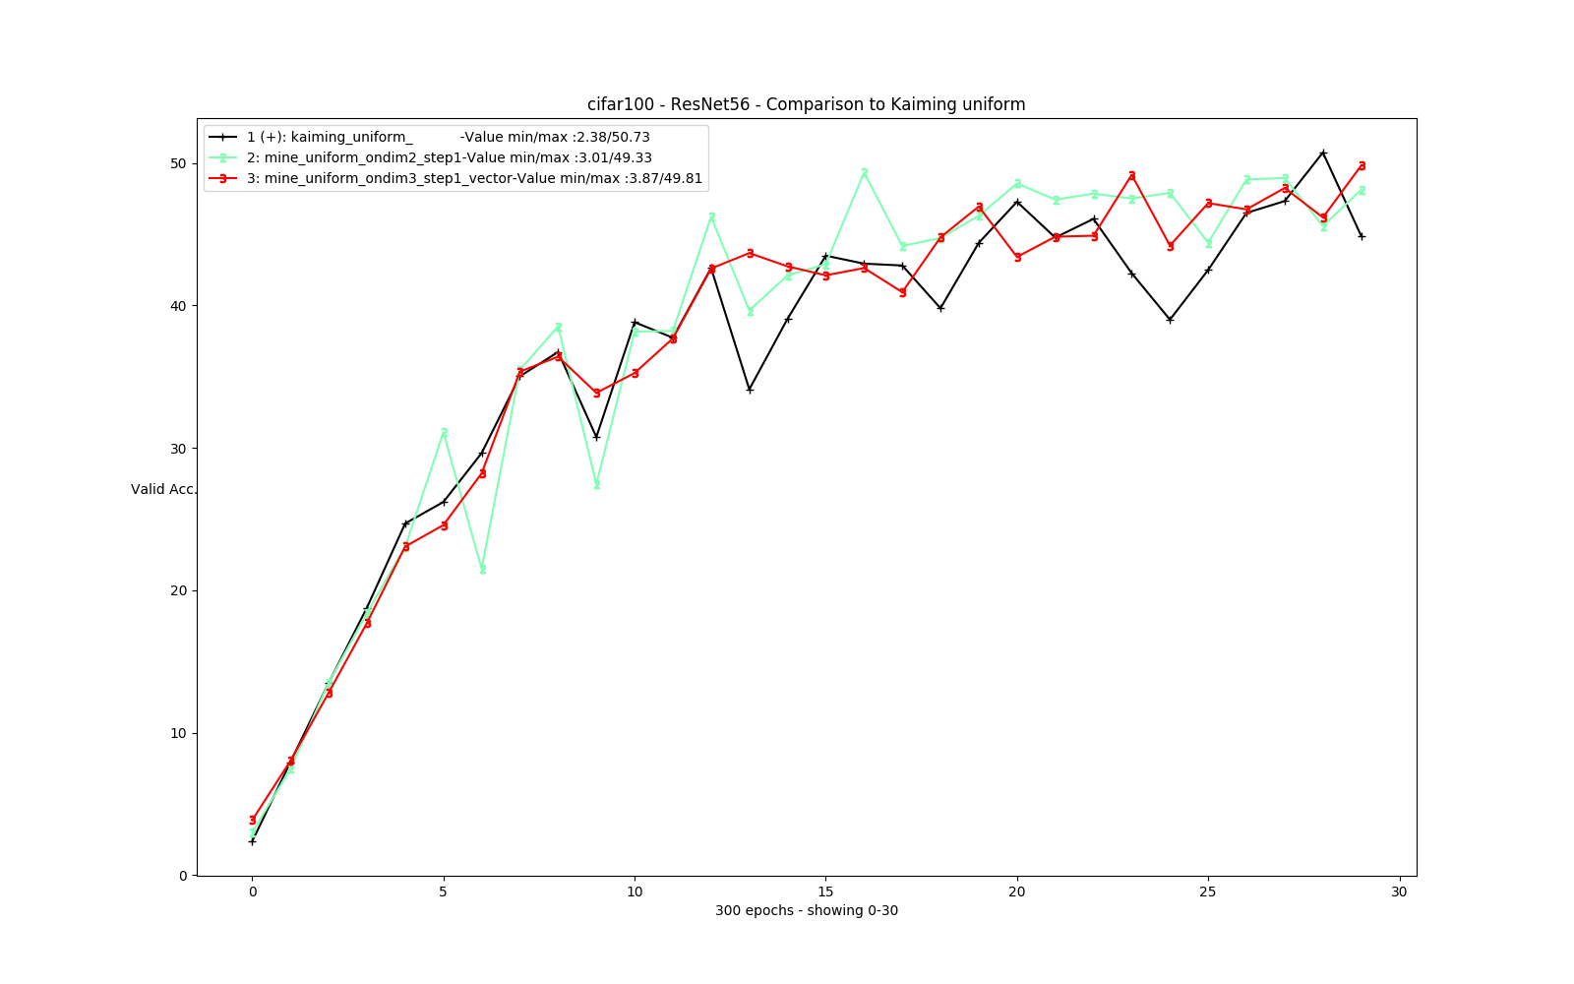
My suggestion – uniform - Results

Slide 41
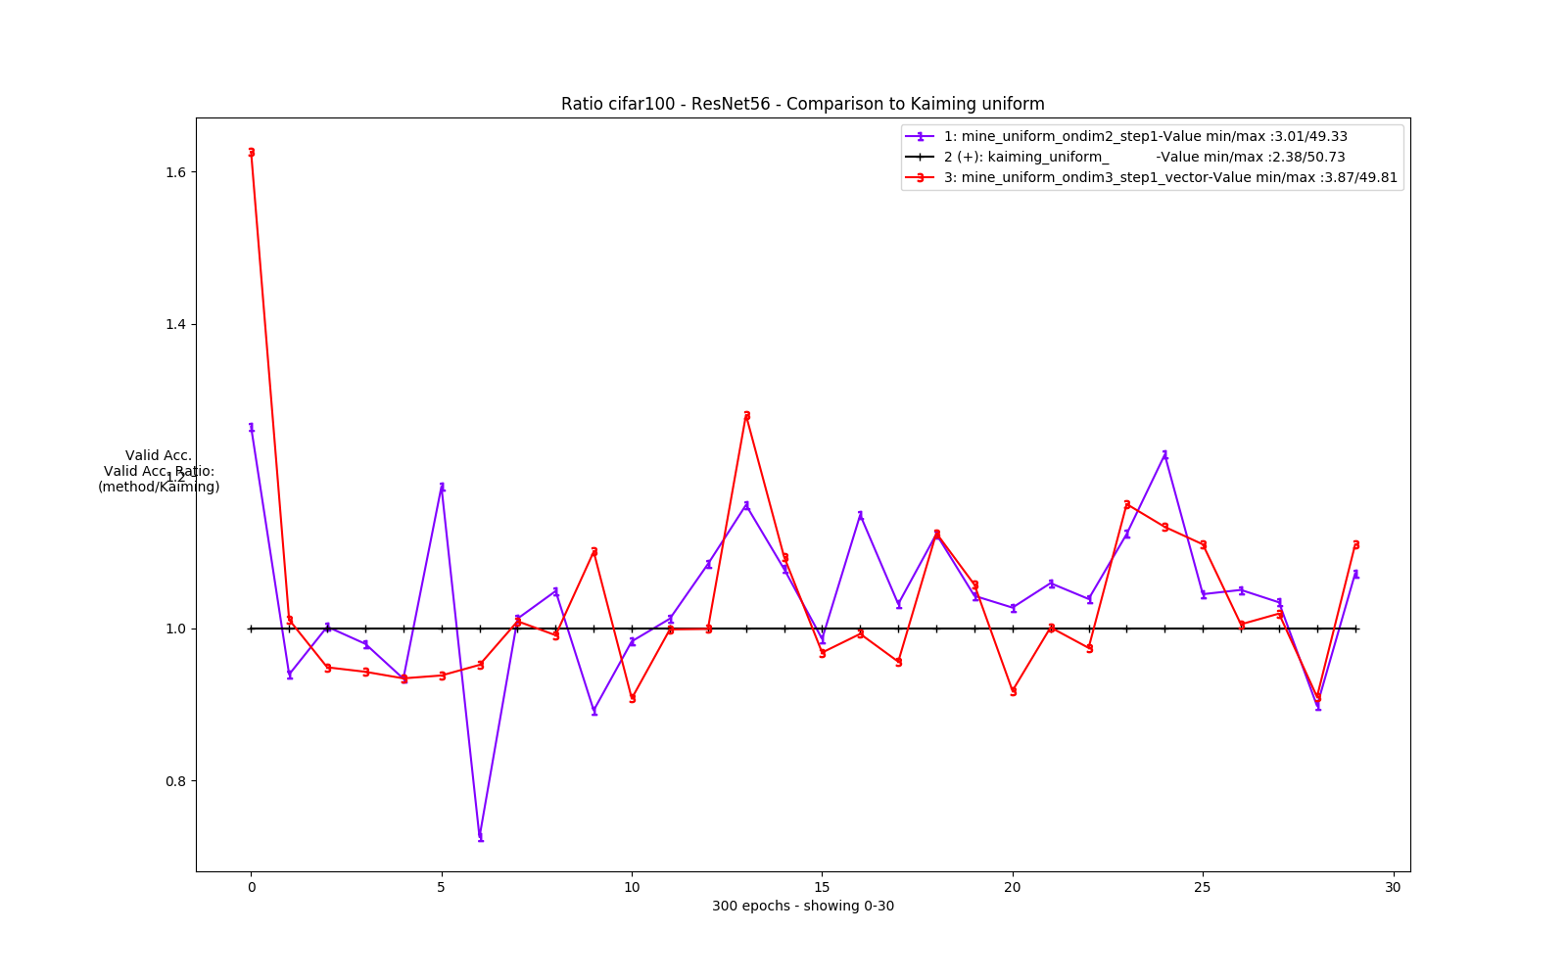
My suggestion – uniform - Results

Slide 42
Thank you
To everyone in the GIP Lab for your patience.
Bonus?

Slide 43
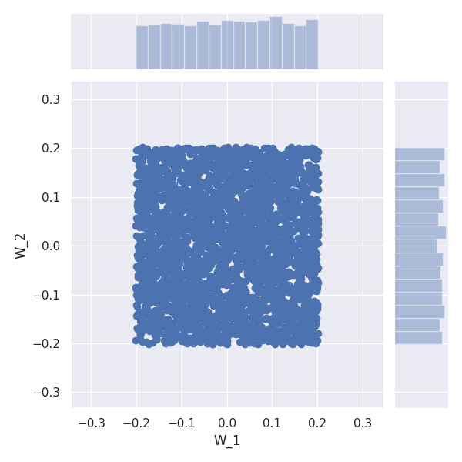
The new suggestion
Lets look at normal and uniform in 2D:

Slide 44
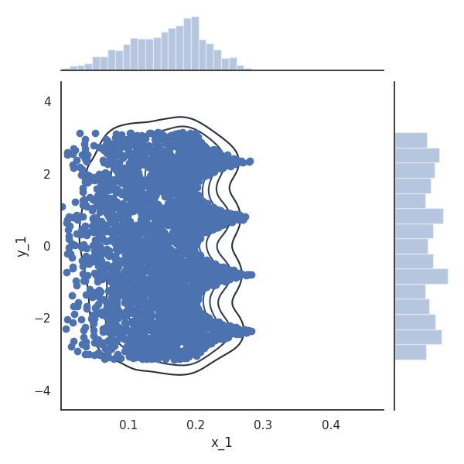
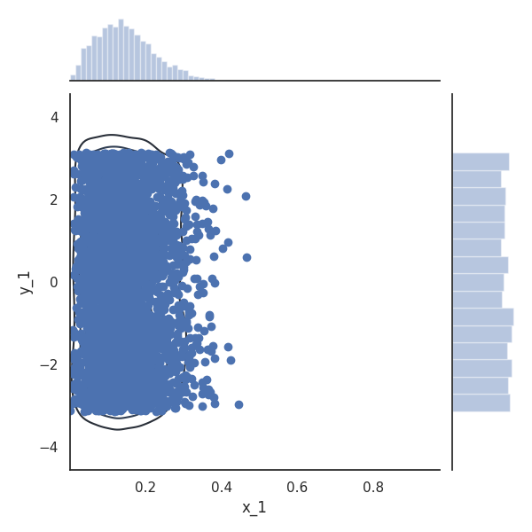
The new suggestion
Lets look at normal and uniform in 2D, in polar coordinated:

Slide 45
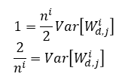
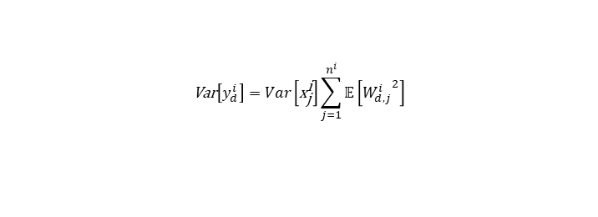
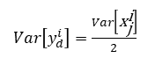













The new suggestion
Lets look at our familiar equations:
$$\text{Var}\left[y_{d}^{i}\right] \text{=} \text{Var}\left[W_{d}^{i}\text{∙}x^{i}\text{+}b_{d}^{i}\right] \\ \text{Var}\left[y_{d}^{i}\right]=\text{Var}\left[W_{d,1}^{i}\text{⋅}{\text{x}}_{\text{1}}^{\text{i}}\text{+}\text{…}\text{+}W_{d,n^{i}}^{i}\text{⋅}{\text{x}}_{n^{i}}^{\text{i}}\right] \\ \text{Var}\left[y_{d}^{i}\right]=\text{Var}\left[\sum_{j=1}^{n^{i}}{W_{d,j}^{i}\text{⋅}{\text{x}}_{\text{j}}^{\text{i}}}\right] \\ \text{Var}\left[y_{d}^{i}\right]= \sum_{j=1}^{n^{i}}{Var\left[W_{d,j}^{i}\text{⋅}{\text{x}}_{\text{j}}^{\text{i}}\right]} \\ \text{Var}\left[y_{d}^{i}\right]=\sum_{j=1}^{n^{i}}{{𝔼\left[{\text{x}}_{\text{j}}^{\text{i}}\right]}^{2}Var\left[W_{d,j}^{i}\right]+{𝔼\left[W_{d,j}^{i}\right]}^{2}Var\left[{\text{x}}_{\text{j}}^{\text{i}}\right]+Var\left[{\text{x}}_{\text{j}}^{\text{i}}\right]Var\left[W_{d,j}^{i}\right]}$$
Me:
$$\text{Var}\left[y_{d}^{i}\right]=\sum_{j=1}^{n^{i}}{{𝔼\left[W_{d,j}^{i}\right]}^{2}Var\left[{\text{x}}_{\text{j}}^{\text{i}}\right]+Var\left[{\text{x}}_{\text{j}}^{\text{i}}\right]Var\left[W_{d,j}^{i}\right]}$$
$$\text{Var}\left[y_{d}^{i}\right]=Var\left[{\text{x}}_{\text{j}}^{\text{i}}\right]\sum_{j=1}^{n^{i}}{{𝔼\left[W_{d,j}^{i}\right]}^{2}+Var\left[W_{d,j}^{i}\right]}$$
They:
$$\text{Var}\left[y_{d}^{i}\right]=Var\left[{\text{x}}_{\text{j}}^{\text{i}}\right]\sum_{j=1}^{n^{i}}{{𝔼\left[W_{d,j}^{i}\right]}^{2}+Var\left[W_{d,j}^{i}\right]}$$
Kaiming:
$$\text{Var}\left[y_{d}^{i}\right]=\sum_{j=1}^{n^{i}}{Var\left[{\text{x}}_{\text{j}}^{\text{i}}\right]Var\left[W_{d,j}^{i}\right]} \\ \text{Var}\left[y_{d}^{i}\right]=n^{i}\left[Var\left[{\text{x}}_{\text{j}}^{\text{i}}\right]Var\left[W_{d,j}^{i}\right]\right]$$
Xavier:
$$\text{Var}\left[y_{d}^{i}\right]=Var\left[{\text{x}}_{\text{j}}^{\text{i}}\right]\sum_{j=1}^{n^{i}}{{𝔼\left[W_{d,j}^{i}\right]}^{2}+Var\left[W_{d,j}^{i}\right]}$$
$Var\left[y_{d}^{i}\right]=\frac{Var\left[{\text{x}}_{\text{j}}^{\text{i}}\right]}{2}$
$$Var\left[y_{d}^{i}\right]= Var\left[{\text{x}}_{\text{j}}^{\text{i}}\right]$$
$$\text{Var}\left[y_{d}^{i}\right]=Var\left[{\text{x}}_{\text{j}}^{\text{i}}\right]\sum_{j=1}^{n^{i}}{𝔼\left[{W_{d,j}^{i}}^{2}\right]}$$
Kaiming:
Xavier:
$Var\left[y_{d}^{i}\right]=\frac{Var\left[{\text{x}}_{\text{j}}^{\text{i}}\right]}{2}$
$$Var\left[y_{d}^{i}\right]= Var\left[{\text{x}}_{\text{j}}^{\text{i}}\right]$$
$$\frac{\text{Var}\left[y_{d}^{i}\right]}{Var\left[{\text{x}}_{\text{j}}^{\text{i}}\right]}=𝔼\left[\sum_{j=1}^{n^{i}}{{W_{d,j}^{i}}^{2}}\right]=𝔼\left[{\left\|W_{d,j}^{i}\right\|}_{2}^{2}\right]$$
$$1=\frac{n^{i}}{2}Var\left[W_{d,j}^{i}\right] \\ \frac{2}{n^{i}}=Var\left[W_{d,j}^{i}\right]$$
$$1= n^{i}Var\left[W_{d,j}^{i}\right] \\ \frac{1}{n^{i}}=Var\left[W_{d,j}^{i}\right]$$
$$\frac{2}{n^{i}}=𝔼\left[{\left\|W_{d,j}^{i}\right\|}_{2}^{2}\right]$$
$$\frac{1}{n^{i}}=𝔼\left[{\left\|W_{d,j}^{i}\right\|}_{2}^{2}\right]$$

Slide 46






The new suggestion
So combining the both…
N-ball $α=0$
N-ring. $α=0.5 (0<α<1)$
N-sphere $α=1$

